Slide 1
Lecture 19a:
5.2.1 Eastern Europe: Rise of Really Existing Socialism
Brad DeLong
Department of Economics & Blum Center, U.C. Berkeley; & WCEG
last revised: Th 2020-04-03
for presentation: Tu 2020-04-07
Original course by Melissa Dell (Harvard Econ 1342), revised by Brad DeLong
<https://github.com/braddelong/public-files/blob/master/econ-135-lecture-19.pptx>
<https://www.icloud.com/keynote/0b5D9ZO7yoYi1Sg5MNWAQbhEw>

Slide 2
Discussion
Touring the Continents: Behind the Iron Curtain
What strikes you as important here?

Slide 3
Behind the Iron Curtain
A separate, discrete system based on “central planning”:
Marx’s hatred of the market:
Saw it as an unequal income distribution mechanism
And as a spur to technological progress and capital accumulation mechanism
Did not see it as an allocative efficiency mechanism
How do you run a “centrally planned” economy?
Material balances and a few crude targets?
Otherwise? Managers buy, beg, barter, steal, trade favors for, and threaten in order to get the resources they need
Appeal to pride of workmanship for quality
“Peaceful coexistence”
The collapse
1:15

Slide 4
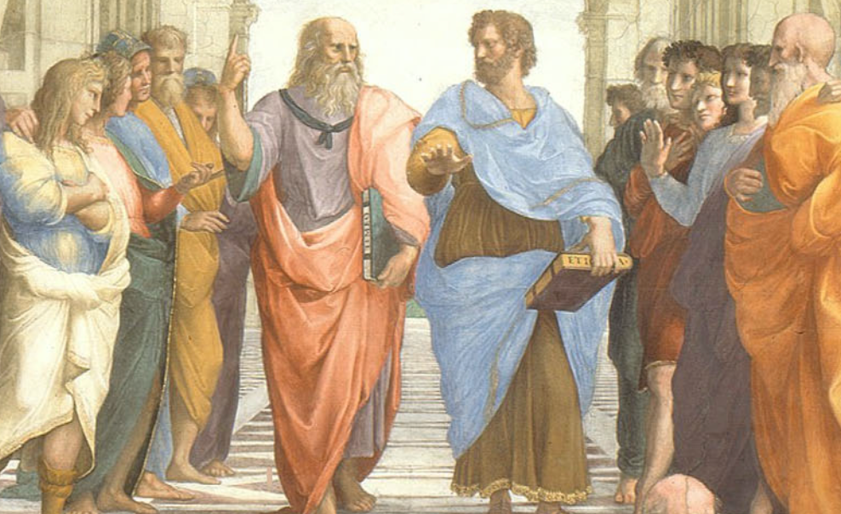
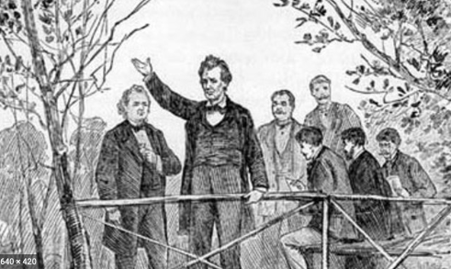

The Rise of Socialism, -350 to 1917
From -350 to 1917:
We will focus on the birth of “really existing socialism”:
Ancient assumptions about inequality
The coming of enlightenment utilitarian values
The question of the proper political order: fears of democracy
Yet democracy and fundamental equality came
Popular government and the market economy: the tension
Technological cornucopia
Popular resistance to industrial socialist ideals
Political democracy insufficient for utopia
An example: governing Chicagoland
Left-wing European politics before World War I
40 minutes of audio
1:30
Notes:
Let’s talk about the rise of socialism, with a focus on the rise of really existing socialism, the system that lived behind what Winston Churchill called the Iron Curtain from 1917-1991, that shook the world, and that in the end turned out to be far, far, far from the brightest light on the tree of humanity’s good ideas. So let’s very briefly race through history—moral, intellectual, political, and social—from the year -350 to the year 1917, when Lenin and his Bolshevik Communist Party staged their coup in Russia, in order to set the stage for that discussion.

Slide 5
Ancient Assumptions About Inequality
Aristotle in the -300s:
Many people “slaves by nature”
This is fortunate, for slavery necessary if there is to be a good society
So it is, and so it always would be
For it is not so only with the mythical technologies of the Golden Age, or of the gods
Even Abraham Lincoln in the mid-1800s:
“I have no purpose to introduce political and social equality between the white and the black races…. I agree with Judge Douglas [that the Negro is not my equal in many respects—certainly not in color, perhaps not in moral or intellectual endowment…”
(But Lincoln then has a “but”:
“There is no reason in the world why the negro is not entitled to all the natural rights enumerated in the Declaration of Independence…. In the right to eat the bread, without the leave of anybody else, which his own hand earns, he is my equal and the equal of Judge Douglas, and the equal of every living man…”
4:30
Notes:
There was a profound shift from the belief in “divine right” and “natural order” as the fundamental grounding for an unequal society to enlightenment values—that human institutions should be rationally designed on the basis of a rational understanding of human psychology in order to attain the greatest good of the greatest number, and thus that inequality is not given by the gods or by the requirements of nature, but rather is a thing to be allowed to the extent that it incentivizes cooperation and industry and thus enriches us all.
Back in the century of the -300s, Aristotle had taken it for granted that a good society was only possible if the society allowed for philosophy. And philosophy was only possible if you had a leisured upper class. And a leisured upper class was possible only with large scale-unfree labor—serfdom, or its harsher cousin slavery. Thus it was and thus it would always, be unless and until humans obtained the fantasy technologies of the mythical Golden Age. That was what Aristotle wrote: that “chief workmen would not want servants, nor masters slaves” only if:
>every instrument could accomplish its own work, obeying or anticipating the will of others, like the [blacksmithing] statues of Daedalus, or the three-wheeled catering serving-carts of Hephaestus, which, says the poet: "of their own accord entered the assembly of the Gods”… the shuttle would weave and the plectrum touch the harp without a hand to guide them…
Thus it was fortunate that:
>It is manifest therefore that there are cases of people of whom some are freemen and the others slaves by nature, and for these slavery is an institution both expedient and just…. There exist certain persons who are essentially slaves everywhere…. Slavery for the one and mastership for the other are advantageous and just, and it is proper for the one party to be governed and for the other to govern by the form of government for which they are by nature fitted, and therefore by the exercise of mastership…
And even in the middle of the 1800s, Abraham Lincoln thought it prudent in the Lincoln-Douglas debates to give a bow to the belief that humans were unequal, grossly unequal, by command of nature or of God:
>I have no purpose to introduce political and social equality between the white and the black races. There is a physical difference between the two, which, in my judgment, will probably forever forbid their living together upon the footing of perfect equality, and inasmuch as it becomes a necessity that there must be a difference, I, as well as Judge Douglas, am in favor of the race to which I belong having the superior position…. I agree with Judge Douglas he is not my equal in many respects—certainly not in color, perhaps not in moral or intellectual endowment…
Before turning on a dime, and making his main point after a “but”:
>There is no reason in the world why the negro is not entitled to all the natural rights enumerated in the Declaration of Independence, the right to life, liberty, and the pursuit of happiness…. In the right to eat the bread, without the leave of anybody else, which his own hand earns, he is my equal and the equal of Judge Douglas, and the equal of every living man…
Moreover, humanity was bout to begin to gain the autonomous robotic blacksmithing statues of master-craftsman Daedalus—and more, a thousand-fold—and also food-production, food-processing, and food-distribution technology vastly outstripping the self-propelled catering carts of Hephaestus the smith-god. Our shuttles now weave without hands to guide them. And as for the need for a hand to guide each making of a musical note—well…
Thus between 1870 and our day it ceased to be a necessity to own or to have some direct or indirect dominion over slaves and near-slaves in order to be rich in material terms and thus approach utopia.

Slide 6

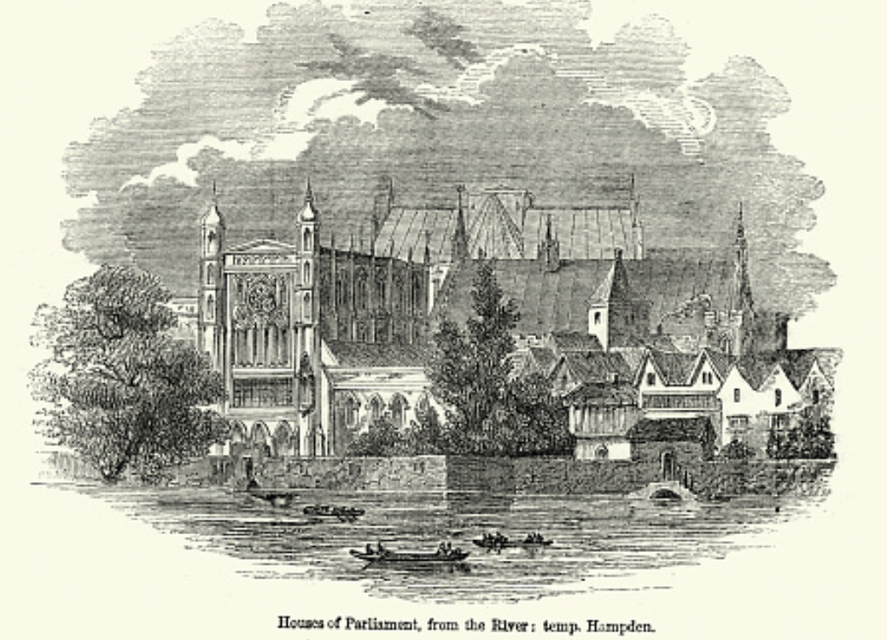
Enlightenment Utilitarian Values
Pre-1870: From “Divine Right” and “Natural Order” to Enlightenment values…
Who was the first person to draft these words:?
John Locke
Niccolo Machiavelli
Thomas Hobbes
Thomas Jefferson
George Washington
“We hold these truths to be sacred & undeniable:
that all men are created equal & independant,
that from that equal creation they derive rights inherent & inalienable,
among which are the preservation of life, & liberty, & the pursuit of happiness;
that to secure these ends, governments are instituted among men, deriving their just powers from the consent of the governed…”
Why did he write them?
2:30
Notes:
Who was the first person to write down words like these?:
>We hold these truths to be sacred & undeniable: that all men are created equal & independant, that from that equal creation they derive rights inherent & inalienable, among which are the preservation of life, & liberty, & the pursuit of happiness; that to secure these ends, governments are instituted among men, deriving their just powers from the consent of the governed…
If people do not consent and believe that the government is vindicating their inherent and inalienable rights that they derive from their equal and independent creation, then it is a sacred and undeniable truth that that government—and the societal order it supports and maintains—is no true government at all.
Do you think the writer was John Locke, Niccolo Machiavelli, Thomas Hobbes, Thomas Jefferson, or George Washington?
Yes, it was Thomas Jefferson in the year 1776.
This is the opening of his first draft of the Declaration of Independence of the United States of America: the glorious statements of (a) fundamental human equality, and (b) equal human rights—to life, liberty, and then what usually shows up as “property” but which TJ called “pursuit of happiness”. Perhaps he wrote it thus to make it broader than just a right to own property and turn it into a right to have one’s own sphere of autonomy within which one could form plans and try to accomplish them to pursue one’s happiness. That broader right simply could not be accomplished by a narrow right to own property, but required and requires much broader support.
But perhaps is was to make the right narrower.
In Virginia in 1776 to assert that it was a “sacred and undeniable” truth that “all men” had an “inherent and inalienable” right to one property would cast considerable shade on the key Virginia institution of slavery—for the slaves had, in Virginia mythology, not only alienated their own inalienable right to own property, but they had alienated their children’s right to own property and their own and their descendants rights to be anything but property.
However, here we are interested in the shift in ideals to enlightenment utilitarian values, rather than in the hypocrisy of the gap between ideals and reality.

Slide 7
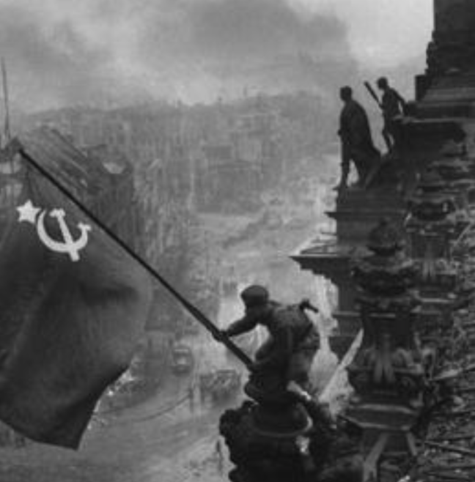
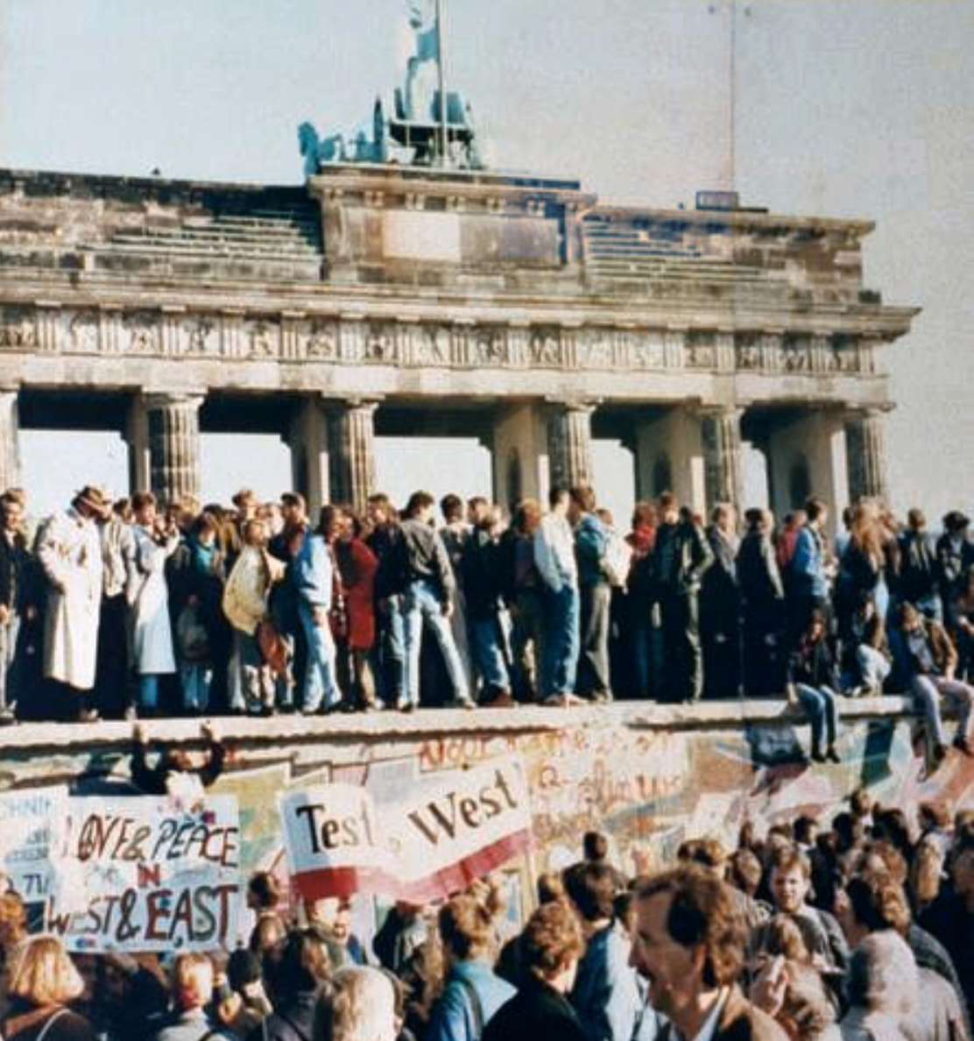
What Was the Proper Political Order?
Fears of “democracy” among American founders:
Madison: “Democracies have ever been spectacles of turbulence and contention... incompatible with personal security or the rights of property... as short in their lives as... violent in their deaths…”
Jefferson: “Gen’l Washington had not a firm confidence in the durability of our government… [& this] had some weight in his adoption of… ceremonies… calculated to prepare us gradually for a change which he believed possible…”
Hamilton: “the British government… best” as the only one “unit[ing] public strength with individual security…”
Adams: The American president should be announced as: “His Highness, the President of the United States, and Protector of the Rights of the Same…”
Question of political order thought settled: first in the rubble of Berlin in 1945, and then in the streets of East Germany in 1991:
Settled in favor of representative democracy, private property, & social insurance—late-1900s liberal democracy
But now reopened? Min Zhu (朱民) to me in 2015: “What are you Americans going to do to fix your broken political system?”
4:00
Notes:
However, accepting the enlightenment values of the U.S. Declaration of Independence—that governments are instituted among humans to vindicate their rights to life, liberty, and the pursuit of happiness; and that governments that do not vindicate those rights and to which humans thus do not consent are no true governments at all—does not give much guidance to what kind of government should be instituted, and what kind of societal order it should support.
In the late 1700s James Madison had not been enthusiastic about democracy:
>Democracies have ever been spectacles of turbulence and contention... incompatible with personal security or the rights of property... as short in their lives as... violent in their deaths…
James Madison had been enthusiastic about a republic. People who counted were to choose a small, select group of representatives who had their values and well-being at heart, but not their passions or their interests. Representatives would then govern subject to procedural checks-and-balances. Under Madison and company’s America constitution, remember, states could restrict the franchise as much as they wished—as long as it preserved “a republican form of government.”
James Madison’s suspicions had been widely shared. His one-time friend and co-author Alexander Hamilton even held that a constitutional monarchy—in which the monarch, the aristocracy, and the masses all held real power to balance one another—was the best of all attainable governments, with “the British government… best” as the only one “unit[ing] public strength with individual security…” And Thomas Jefferson suspected George Washington thought Hamilton was right, and that the American republic might fail: “General Washington had not a firm confidence in the durability of our government”. Jefferson thought this fear “had some weight in his adoption of… ceremonies… calculated to prepare us gradually for a change which he believed possible.” And John Adams proposed that the American president be announced as: “His Highness, the President of the United States, and Protector of the Rights of the Same”.
We had thought that the questions of political order had been settled first in the rubble of Berlin in 1945, and then in the streets of East Germany in 1991: We had thought they had been settled in favor of representative democracy that balanced off interests and got as close as possible to the will of the median voter necessary for proposals to command majority assent, while having sufficient constitutional checks-and-balances to ensure the protection of minority rights. (Rather than a “leadership state” in which popular unity was created by obeying the commands of a visionary ruler). We had thought they had been settled in favor of private property, a mixed economy, and social insurance. (Rather than either a laissez-faire “free to starve” system or a command economy directed by the elite cadres of a ruling party that possessed the intellectual key to the lock that guarded the riddle of historical development. )
We had thought that the questions had been settled in favor of constitutional representative and liberal democracy, plus a private-property market-heavy mixed economy with social insurance.
But are these now reopened? As senior Chinese leader Min Zhu (朱民) said to me—with absolutely no trace of irony at all—back in 2015: “What are you Americans going to do to fix your broken political system?”

Slide 8
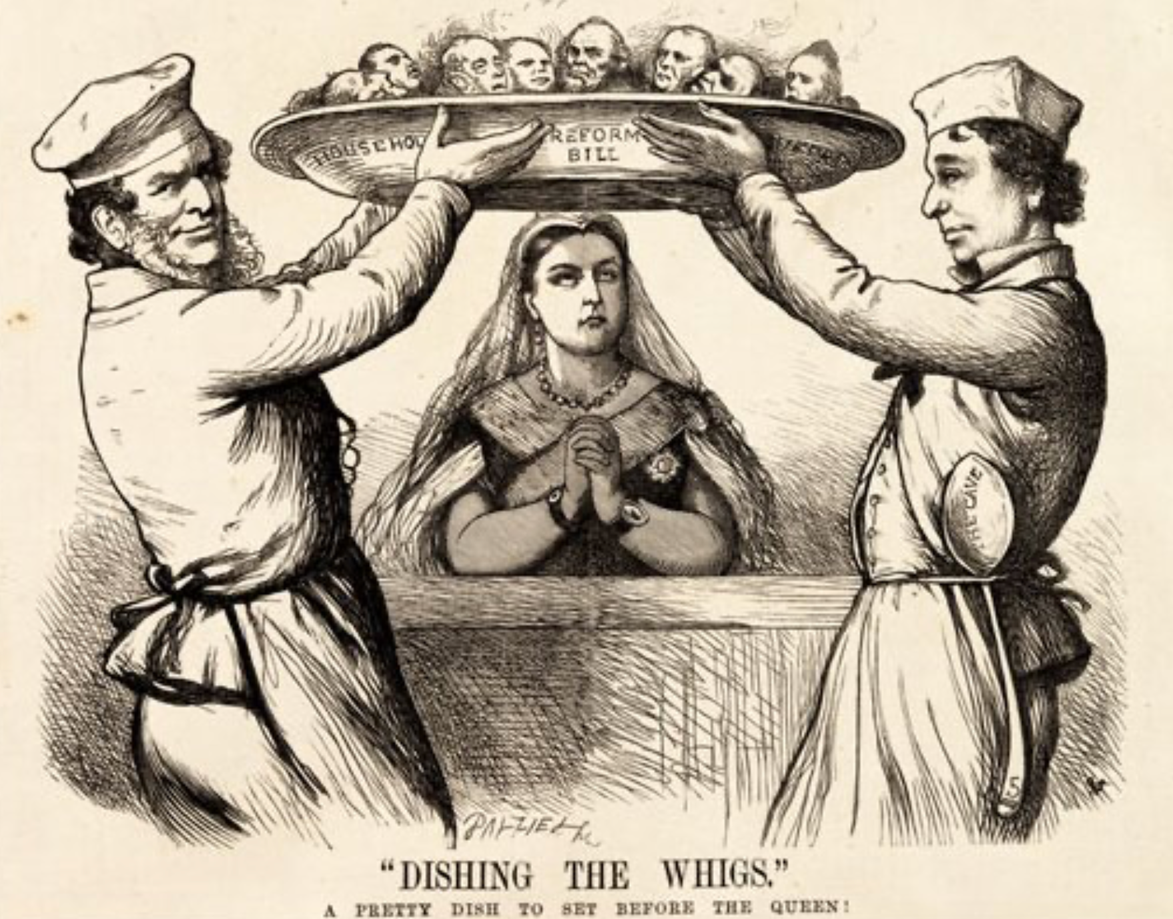
Yet Democracy and Fundamental Equality Came…
Franchise Restricted to the Rich Could Not Maintain Itself:
The dynamic of franchise extension
Liberals in power would try extend on the principle that the new, poorer voters would be less conservative and would support them.
Threatening revolution would lead even conservatives to seek to extend the franchise in order to peel off of the revolutionary coalition those of the disenfranchised who had the most social power:
Earl Grey (yes, the tea): “The Principal… is to prevent… revolution…. I am reforming to preserve, not to overthrow…”
Charismatic leaders with popular followings would seek to give them votes, and then rule via plebiscites—going around the traditional elites
(Peculiar thing about Trump-Johnson: minority, and core is a minority of a minority…)
Conservatives: “dish the Whigs”—opportunities to form winning coalitions by appealing to those who were no profiting from the market economy, or felt that they were losing relative status in some ways…
5:15
Notes:
In spite of fears about the instability and irrationality of democracies and the desirability of keeping politics in the hands of sober successful people with property, as the 1800s moved forward, democracy—at least in the form of one male of the right age and race, one vote—as the touchstone of political legitimacy made massive strides, if at deliberate speed. Claims that kings ruled by divine right and that aristocracies ruled by virtue of their ancestors having been among those who conquered the Anglo-Saxons with William of Normandy or the Romano-Gauls with Clovis the Frank became increasingly risible and ran aground. So many aristocrats were noble because their ancestors had been fixers, pimps, or bureaucrats for past kings.
For a while prosperity was an alternative touchstone: rulers should be elected or at least advised by those selected by vote, yes, but by a vote of the prosperous. François Guizot, left-of-center Prime Minister of France’s constitutional monarchy in the early 1840s, responded to demands for a broader electoral franchise with the words “enrichessez vous”: if you want to vote, get rich enough that you qualify. It did not work. On February 23, 1848, King Louis-Philippe of France’s Orleanist dynasty—the only king of the Orleanist dynasty—threw Guizot over the side in the hope of avoiding revolution and dethronement. Louis Philippe abdicated the following day.
Worldwide, politicians on the left wanted, eventually, more than one person-one vote. They sought the abolition of private property and the rational distribution of the products of the societal division of labor… well, by it was not clear what. But that position was rejected by the bulk of political society: only rarely could it win any majorities for its position that the government should have a totalizing role—that all questions should be settled and all social life organized by a government, in which each one counted for one and one alone.
Worldwide, politicians on the right held the view that some existing inequalities of wealth, influence, and political power were just or holy or both. But they were divided. Some viewed inequalities emerging from the creative destruction and accumulation of the market with, at best, suspicion. Others viewed inherited and status inequalities with grave suspicion. Some tried to reconcile and exalt all the groups of inheritors, entrepreneurs, and crony capitalists, but that was a difficult balancing act.
Thus the balance point was in the middle. Over the 1800s the political principle that caused the least offense to the greatest number being that political society would be a realm in which some or most of the male individuals’ preferences counted equally in choosing the government, and that the government would then curb and control the economy, to limit but not extinguish the extra influence of those whom American Republican President Theodore Roosevelt called the “malefactors of great wealth” early in the 1900s.
When the left of center was in power they would try extend on the principle that the new, poorer voters would be less conservative and would support them.
When conservatives were in power they might convince themselves to extend the suffrage, on the grounds that the workers were loyal to king and country, were being exploited by the merchant, manufacturing, and commercial agricultural classes, and would be grateful: it would “dish the Whigs”.
When revolution threatened, governments fearing armed mobs in the streets would decide that franchise extension would divide the potentially-revolutionary opposition: “The Principal… is to prevent… revolution…. I am reforming to preserve, not to overthrow,” said Earl Grey in the debate over the 1831 franchise-extension reform bill.
Thus extension of the suffrage tended to creep forward, step by step. Up until 1913, at least in the increasingly prosperous North Atlantic industrial core of the world economy, the prospects for increasing and stabilizing democracy looked good.
Franchise expansions put real power in the hands of poorer and less aristocratic voters—or, rather, of those they chose as their representatives. Thus even aristocrats sought to make them able to wield that responsibility. British cabinet member Robert Lowe argued that after making the richer segment of the working class the masters of the government: “we must educate our masters”.
Sometimes—as with Britain’s Benjamin Disraeli, or Germany’s Otto von Bismarck—conservatives even led the way in extending the franchise, thinking that poor rural voters had more in common with landlords than with plutocratic industrialists and the urban bourgeoisie; and that poor urban voters would hate those who screwed down their wages more than those who sought to preserve ties of authority and respect between rich and poor.

Slide 9
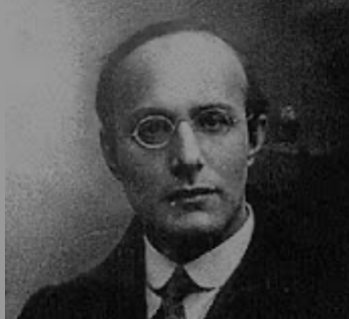
Popular Government and the Market Economy: The Tension
Karl Polanyi
People believe they have rights—to stable, supportive, nurturing communities; to incomes commensurate with their skills and status; and to money flows that will provide economic stability…
But a market society turns these things—land, labor, and finance—into commodities…
But they are not real commodities, they are fictitious commodities
And so you get your rights only if they satisfy a market profitability test
The only rights a market society respects are property rights:
& the only property rights that are worth anything are those that help you produce things for which rich people have a serious jones
Society will have its revenge: it will protect itself against the market logic, somehow, some way…
7:15
Notes:
There was or would be great tension between the political voice and power that came with one man-one vote democracy and the market economy.
In a later day, Friedrich von Hayek always argued that to inquire whether a market economy’s distribution of income and wealth was “fair” or “just” was to commit a fatal and basic intellectual blunder. “Justice” and “fairness” of any form requires that you receive what you deserve. But a market economy gives not to those who deserve well,. T but rather those who happen to be in the right place at the right time to control resources that are valuable for future production. Once you step into the morass of “social justice”, Hayek believed, you would be forced into adjustment after adjustment. You would not be able to stop chasing a “just” and “fair” outcome “until the whole of society was organized… in all essential respects… [as] the opposite of a free society.”
Note that Hayek did not believe (much) in inherited feudal, guild, and customary blockages to decentralized market exchange: they should be steamed away. Then the market would giveth; the market would taketh away; and blessed would be the name of the market. That a market economy can produce a highly unequal and can produce a less unequal distribution of income and wealth was besides the point. We lacked and would always lack the knowledge to create a better society.
The only rights the market economy recognizes are property rights—and then it only recognizes those property rights that are valuable, and the most valuable property rights are those useful in making things for which the rich have a serious jones.
Yet people thought they had other rights than just the rights that accrued to the property they happened to hold. They had bigger and more fundamental objections to a market society than just the objection that it makes some rich and others poor.
Hungarian-Jewish moral philosopher Karl Polanyi wrote during World War II in his book The Great Transformation, not everything is or can be a commodity: making some things into commodities is a fiction. A market society will thus face a backlash—it can be a left-wing, it can be a right-wing backlash, but there will be a backlash, and it will be powerful. Polanyi wrote about how land, labor, and finance were “fictitious commodities” that could not be governed by the logic of profit-and-loss but had always and needed to be embedded in society and managed by the community taking account of religious and moral dimensions. These were—are—brilliant insights. But in The Great Transformation they are incomprehensible to an overwhelming proportion of those who try to read Polanyi.
Let me try to put it better:
The market economy believes that the only rights that matter at all are property rights. The market economy believes that the only property rights that matter a lot are those that produce things for which the rich have high demand.
But people believe that they have other rights:
* With respect to land, people believe that they have rights to a stable community: that the natural and built environment in which they grew up or that they made with their hands is theirs, whether or not market logic says it would be more profitable and lucrative if it were different or if somebody else lived there.
* With respect to labor, people believe that they have rights to a suitable income: they have prepared for their profession, they have played by the rules in so doing, and so society owes them a fair income commensurate with their preparation, whether or not the world market’s logic says that what they make has a free-market price that can support that income or not.
* With respect to finance, people believe that as long as they do their job of working diligently, the flow of purchasing power through the economy should be such as to give people the wherewithal to buy. The decisions of rootless cosmopolite financiers who may be thousands of miles away that this or that flow of purchasing power through the economy is no longer sufficiently profitable, and so should be shut off, should not be able to make your job dry up and blow away.
Note that these rights that society will attempt to validate do not—or might not—be rights to anything like an equal distribution of the fruits of industry and agriculture. And it is probably wrong to describe them as fair: they are what people expect given a certain social order of society. A market order that generates wages seen as too high for Chinese immigrants and opportunities seen as insufficient for white Californians seeking jobs in agriculture will call forth riots and a Chinese Exclusion Act in California late in the 1800s. A market order that generates too much Polish spoken on too many German-owned farms in the early 1900s will start German right-wingers thinking about the drang nach osten, by which the military-religious order of the Teutonic Knights pushed the German-Slavic language frontier a couple of hundred miles east in the Middle Ages. A market order that replaces blue-collar assembly-line worker jobs with robots while generating new jobs only in big liberal cities early in the 2000s will generate “economic anxiety”.
But society will not like the tension between the market economy and its beliefs about the rights governments should vindicate. And as, with one man-one vote, society rather than its comfortable upper stratum gains political voice, it will seek a political solution: it will seek something that people will call “socialism”.

Slide 10
Popular Resistance to Industrial Socialist Ideals
The June Days of 1848 in Paris:
Tocqueville:
“The insurrection of June [1848]... class against class... a blind and rude, but powerful, effort on the part of the [urban] workmen to escape from the necessities of their condition, which had been depicted to them as one of unlawful oppression…. The closing of the national workshops… occasioned the rising…”
“Thousands… hastening to our aid from every part of France.... Thanks to the railroads, some had already come from fifty leagues’ distance... every class of society... peasants... shopkeepers... landlords and nobles all mingled together... they rushed into Paris with unequalled ardour: a spectacle as strange and unprecedented in our revolutionary annals.... The insurgents received no reinforcements, whereas we had all France for reserves…”
1:45
Notes:
Left-wing socialists believed that the backlash to the market would produce overwhelming popular revolutionary demands for a government to take control of the economy and guarantee jobs at equal and fair wages for all. They were to be surprised and astonished when the mass of the people disagreed.
We first saw this in 1848, in the June days of Paris. Urban workers wanted the government to guarantee full employment and fair wages in publicly-funded and -run urban workshops. They sought to overthrow the government. They found that the peasants disagreed: The peasants had gotten their farms in the Great French Revolution half a century earlier. They did not want urban workers to seize control and force them to pay higher taxes to support urban layabouts who ought to go back to their families’ farms when there was no work in the city.
French intellectual and politician Alexis de Tocqueville was amazed. He wrote of:
>The insurrection of June [1848]... class against class... a blind and rude, but powerful, effort on the part of the [urban] workmen to escape from the necessities of their condition, which had been depicted to them as one of unlawful oppression…. The closing of the national workshops… occasioned the rising….
>Thousands… hastening to our aid from every part of France.... Thanks to the railroads, some had already come from fifty leagues’ distance... every class of society... peasants... shopkeepers... landlords and nobles all mingled together... They rushed into Paris with unequalled ardour: a spectacle as strange and unprecedented in our revolutionary annals.... The insurgents received no reinforcements, whereas we had all France for reserves…

Slide 11
Political Democracy Insufficient for Utopia
America in 1900: “‘Land of opportunity’, you say. You know well my children will be where I am—that is, if I can keep them out of the gutter”:
Who was to blame for inadequate opportunity?: the rich, the easterners, immigrants, and the bankers (Jews)… <Matthew 21:33-46>
What was to be done?: Populists:
Free coinage of silver at a ratio of 16-to-1…
Boost the money supply…
Lower interest rates…
Raise farm prices…
Antitrust to bust monopolies and restore competition…
Railroad and other forms of rate regulation…
Populist and Progressive movements broken on the anvils of racial animosity, & fear of left-wing socialism, & belief—hope—that the proper business of America was business, and that America contained no proletarians for we were all just temporarily embarrassed millionaires…
5:15
Notes:
America in the late 1870s—in spite of its absence of a true plutocratic aristocracy (outside of the south) and early achievement of stable democacy with one (white) man-one vote—also found that political democracy and liberty were insufficient for utopia. America was no exception to the societal judgment that the market economy was going wrong. By 1900 the United States was as unequal an economy in relative terms as—well, today. it had become the Gilded Age country of industrial princes and immigrant tenements. 146 largely-immigrant workers died in the 1911 Triangle Shirtwaist Factory ﬁre in Manhattan. Why? Because the exits had been locked to keep workers from taking fabric out of the building in order to make their own clothes.
Alexis de Tocqueville, a keen-eyed commentator on American society in the ﬁrst half of the nineteenth century, had feared this, for while:
>the territorial aristocracy of past ages… [was] obliged… to come to the help of its servants and relieve their distress
no such reciprocal ties of obligation bound the aristocrats of manufactures to their workers: thus:
>the manufacturing aristocracy which we see rising before our eyes is one of the hardest that have appeared on the earth…
Abraham Lincoln had thought he lived, and to some degree had lived, in an America in which :
>the prudent, penniless beginner… saves a surplus… and at length hires another new beginner to help him…
And so he took:
>it that it is best for all to leave each man free to acquire… [and] get wealthy…
In America as Lincoln saw, there was always opportunity—save for in the slave South, where African-Americans had no opportunity and whites who did not own slaves had little.
But by 1900 the workers of Lincoln’s Illinois saw things differently: “‘Land of opportunity’, you say. You know well my children will be where I am—that is, if I can keep them out of the gutter.” Things weren’t working. The market economy had, somehow, become unfair.
Many of the middle class, especially the farmers, blamed the rich, the easterners, immigrants, and the bankers for what was going wrong with late nineteenth-century America.
The Populists of the 1890s sought the free coinage of silver at a ratio of 16-to-1 to boost the money supply, lower interest rates, and raise farm prices. They sought antitrust to bust monopolies and restore competition. They sought railroad and other forms of rate regulation to make sure that the largely-rural backbone of real Americans were not exploited by those in the cities with market power—whether rail barons, manufacturing monopolies, or bankers.
They blamed the eastern bankers, the gold standard, the monopolists, the immigrants, and—and this was what broke them as a political movement—the African Americans. Rich Bourbon establishments in the south could and did win votes by segregating and disenfranchising African-Americans. And so southern American populism died as a political force.
The Progressives of 1900 sought reforms to try to diminish the power of what they saw as a wealthy-would be aristocracy: the “malefactors of great wealth” in Theodore Roosevelt’s words. They sought an expanded government role to protect the environment, a progressive income tax, curbs on financial manipulation, and also to make the world safe for democracy.
The Progressives got their chance when the assassination of William McKinley moved Republican Progressive Theodore Roosevelt out of the Vice Presidency—the powerless job dismissed by John Nance Garner as “a bucket of warm piss”—and into the White House in 1899, and then again when Roosevelt’s disgust at his successor Taft’s betrayal of Progressive values and sharp, corrupt Republican National Convention practice led him to throw the presidency to Democratic Progressive Woodrow Wilson in 1912.
However, these remained minority political currents in America. Voters typically elected Republican presidents—or that triangulating bastard Grover Cleveland—who were more-or-less satisfied with American economic and social developments, and who believed that “the business of America is business.”
The Populist and Progressive movements in America around 1900 were broken on the anvils of racial animosity, & fear of left-wing socialism, & belief—hope—that the proper business of America was business, and that America contained no proletarians for we were all just temporarily embarrassed millionaires…

Slide 12
An Example: Governing Chicagoland
Chicago 1840: 4000. Chicago 1900: 2,000,000—70% born outside the United States:
1886: AFL general strike for the 8-hour workday: Haymarket bombing May 3 (8/20)
1889: AFL President Samuel Gompers; May Day
1893: Altgeld pardons three surviving “Haymarket bombers”—blames Pinkertons
1894: TTB Grover Cleveland: Labor Day holiday in September instead
1894: Pullman Strike
Cleveland attached a mail car to every train
Cleveland ordered the U.S. army into Chicago
Art. IV §4: “on application of the [state] legislature, or the executive (when the legislature cannot be convened).”
Altgeld pointed out that neither he nor the legislature had applied
Cleveland responded that it was more important to protect property against rioters, anarchists, and socialists: “If it takes the entire army and navy of the United States to deliver a postcard in Chicago, that card will be delivered!”
On July 7, 1894 Debs and the other union leaders were arrested for violating the terms of the injunction, and the strike collapsed
But the center of the electorate did not want Populism, or Progressivism…
5:15
Notes:
Let us take a look at economics and politics interacting at the bleeding edge—at the most-rapidly growing and industrializing place on the pre-World War I earth, in that era’s counterpart to today’s Shenzhen: Chicago.
In 1840, when the Illinois and Michigan canal opened connecting the Mississippi River with the Great Lakes, Chicago had a population of 4000. In 1871 Mrs. O’Leary’s cow burned down a third of the city. In 1885 Chicago built the world’s first steel-framed skyscraper. By 1900 Chicago had a population of two million. 70 percent of its citizens had been born outside the United States.
On May 1, 1886, the American Federation of Labor declared a general strike to win the eight-hour workday. On May 3, 400 police officers protecting the McCormick farm equipment factory and its strikebreakers opened fire on a crowd, killing six. The next day eight police officers were murdered by an anarchist bomb at a rally in protest of police violence and in support of the striking workers—and the police opened fire at the crowd and killed perhaps twenty civilians, largely immigrants, largely non-English speaking (nobody seems to have counted). A kangaroo court convicted eight innocent left-wing politicians and organizers of murder. Five were hanged. In 1893 Democratic Governor John Peter Altgeld pardoned the surviving innocent “bombers”.
In 1889 Samuel Gompers, President of the American Federation of Labor asked the world socialist movement—the “Second International”—to set aside May 1 every year as the day for a great annual international demonstration in support of the eight-hour workday and in memory of the victims of police violence in Chicago in 1886.
In the summer of 1894 the Democratic Party President Grover Cleveland persuaded Congress to make a national holiday in recognition of the place of labor in American society—not on the International Workers’ Day that was May 1 in commemoration of Chicago, but rather a moveable feast on the first Monday in September instead.
As Governor of Illinois, Altgeld lobbied for and persuaded the legislature to enact the then-most stringent child labor and workplace safety laws in the nation, increased state funding for education, and appointed women to senior state government positions. The largely-Republican and Republican-funded press condemned John Peter Altgeld for his Haymarket pardon. For the rest of his life he was, to middle-class newspaper readers nationwide and especially on the east coast, the foreign-born alien anarchist, socialist, murderous governor of Illinois.
On May, 11, 1894, workers of the Pullman Corporation, manufacturer of sleeping cars and equipment, went on strike rather than accept wage cuts. The railroads asked the government to come in on their side, and that Triangulating Bastard President Grover Cleveland—the only Democrat elected president between James Buchanan and Woodrow Wilson—decided to grant their request. He attached a mail car to every train, thus making blocking any train an interference with the U.S. mail and thus a federal crime. United States Attorney General Richard Olney got the courts to enjoin the strikers, forbidding the obstruction of trains and forbidding providing any assistance to anyone obstructing trains.
Cleveland ordered the U.S. army to deploy in Chicago.
Illinois Governor Altgeld protested. Altgeld pointed out in two telegraphs to Cleveland that Art. IV §4 of the Constitution gives the power to the President to use troops inside states against domestic violence only “on application of the [state] legislature, or the executive (when the legislature cannot be convened).” Altgeld pointed out that neither he nor the legislature had applied. Cleveland responded that it was more important to protect property against rioters, anarchists, and socialists: “If it takes the entire army and navy of the United States to deliver a postcard in Chicago, that card will be delivered!”
On July 7, 1894 Debs and the other union leaders were arrested for violating the terms of the legal injunction, and the strike collapsed.
At the next election Altgeld led a revolt that ran President Cleveland out of the party. Altgeld sought to get the Democratic Party to nominate former U.S. Senator Richard P. Bland. The young William Jennings Bryan, however, had other ideas. Bryan wowed the convention. Grover Cleveland and his supporters then ran ex-Republican Illinois governor and ex-Union general John M. Palmer and ex-Kentucky governor and ex-Confederate general Simon Bolivar Buckner to split off votes from William Jennings Bryan and Arthur Sewall. Bryan and Sewall lost to McKinley and Hobart—with a swing of -500000 votes relative to the average of the last five elections, 3.5% of the electorate. The crucial swing voters in the American electorate did not then want a Democratic candidate from the Democratic wing of the Democratic Party.

Slide 13
Left-Wing European Politics Before World War I
Disjunction between policies and rhetoric: the reform planks:
The Socialist Party of Germany’s Erfurt and Gotha programs seek things like: holidays for elections, two-year legislative terms, the right to bear arms, equal rights for women, the prohibition of spending public funds for religious purposes, free public schools and colleges, free medical care including midwifery, an eight-hour working day, no child labor under 14, a 36-hour minimum weekend, an occupational safety and health administration…
Disjunction between policies and rhetoric: the revolution planks:
But also: “By every lawful means to bring about a free state and a socialistic society, to effect the destruction of the iron law of wages by doing away with the system of wage labor.” And they sought: “the transformation of the capitalist private ownership of the means of production—land and soil, pits and mines, raw materials, tools, machines, means of transportation—into social property and the transformation of the production of goods into socialist production carried on by and for society.” And they believed: “This… emancipation… of the entire human race…. But it can only be the work of the working class, because all other classes… have as their common goal the preservation of the foundations of contemporary society…”
2:45
Notes:
In Europe, also, the center of the electorate was fearful of the unregulated market economy, yet also fearful of a left-wing socialism that looked hazily forward to some form of revolution and a utopia in which private property would not be. And socialist parties were hopelessly confused.
On the one hand the policy changes they asked for now were weak tea: the reform plans were mild. The Socialist Party of Germany’s Erfurt and Gotha programs sought things like: holidays for elections, two-year legislative terms, the right to bear arms, equal rights for women, the prohibition of spending public funds for religious purposes, free public schools and colleges, free medical care including midwifery, an eight-hour working day, no child labor under 14, a 36-hour minimum weekend, an occupational safety and health administration
But then they also looked forward to revolution—and to class war. They did say that the revolution would be peaceful: “By every lawful means to bring about a free state and a socialistic society…”
But their goals were maximal.
This peaceful. legal, constitutional revolution would “effect the destruction of the iron law of wages by doing away with the system of wage labor…”
This peaceful. legal, constitutional revolution would lead to large-scale confiscations of all private property: “The transformation of the capitalist private ownership of the means of production—land and soil, pits and mines, raw materials, tools, machines, means of transportation—into social property and the transformation of the production of goods into socialist production carried on by and for society…”
And they believed in class war, or at least that the industrial working class was the only class that had a right to govern: “This… emancipation… [is] of the entire human race…. But it can only be the work of the working class, because all other classes… have as their common goal the preservation of the foundations of contemporary society…”
Hence there was an immense gap between their poli

Slide 14
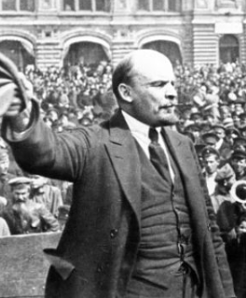
Creating Socialism in Russia
The twilight of the Czarist régime
Coming of “western” democratic and socialist ideas
A short unvictorious war
Nicholas II Romanov’s government nevertheless grabbed with both hands for World War I
Collapse of the Czar’s government
Lenin’s quick power grab…
Confidently expecting a German revolution, and then massive aid…
Brutal civil war
Kerenskyites
Reds
Whites
Nationalists
What was the revolutionary government to do?
Ludendorff’s German war economy…
22:15 minutes of audio
2:15
Notes:
Before World War I, almost all observers—including the Czar’s government—had long seen Czarist Russia as heading for a revolution. In 1914 Russia was perhaps half as rich as the United States and two-thirds as rich as Germany, and more unequal than both: figure four dollars a day as a typical standard of living. Life expectancy at birth was barely thirty years at a time when western Europe was 50, and the United States 55. Its wealthy classes were dominated by aristocratic landlords who had no functional societal role. Its educated classes were in close cultural contact with western Europe, especially France: only one of the first 68 words of Tolstoy’s novel War and Peace is Russian—pomest’ya, a feudal estate governed by the rules of lordship and vassalage rather than private property. The other 67 words are French. Ideas about equality before the law, governments deriving their just powers from the consent of the governed, meritocracy and the end of caste-status privileges, and constitutions had been flowing into Russia through the window on the West that was the Czar Peter the Great-built Baltic Sea port capital of St. Petersburg for centuries.
The Czarist regime barely survived the uprising of 1905 triggered by the short unvictorious war against Japan. Yet rather than avoid war in 1914, Nicholas II Romanov and his advisors embraced it. And the Czarist régime did not survive. The Czar, without supporters, fell.
A Russian Republic was proclaimed. The semi-socialist Kerensky government that followed tried to continue the war against Germany on the side of Britain, France, and America. It organized an election for a constituent assembly to write a constitution for a democratic-socialist Russia. Kerensky’s republic was then overthrown in a coup by Vladimir Lenin and his Bolsheviks seven months later in their October Revolution.
Lenin was not interested in democracy. Lenin sent the Constituent Assembly home at bayonet point, and decided to form Marx’s dictatorship of the proletariat—although how you could have an industrial working class that barely existed run a dictatorship was unclear.

Slide 15
Winning the Civil War
Lenin’s quick power grab…
Confidently expecting a German revolution, and then massive aid…
Brutal civil war
Kerenskyites
Reds
Whites
Nationalists
War
Commissars
Secret policemen
Lenin’s character:
“I know nothing that is greater than the Appassionata [by Beethoven]; I'd like to listen to it every day [Lenin said].... What marvelous things human beings can do! But... music... makes you want to say stupid nice things, and stroke the heads of people who could create such beauty while living in this vile hell. And now you must not stroke anyone's head: you might get your hand bitten off. You have to strike them on the head, without any mercy, although our ideal is not to use force against anyone. Hm, hm, our duty is infernally hard…”
3:30
Notes:
For a government to survive when there are no powerful social classes or interest groups that have ideological allegiances or substantive reasons to back it requires great ruthlessness. A brutal Civil War followed.
“White” supporters of the Czar, local autocrats seeking effective independence, Lenin’s “Red” followers, stray other forces— including a Czech army of ex-prisoners-of-war that found itself effective ruler of Siberia for a while, plus Japanese regiments—fought back-and-forth over much of Russia for three years. The United States sent both troops to secure base areas for anti-Communist forces, and food to feed Russians (and Red Army soldiers) in Communist-controlled areas.
It soon became clear that volunteer cadres with their own elected officers were not very effective: the Communist government needed to draw on the skills of the old Czarist army officers. But could they be trusted? Leon Trotsky, Commissar for War, came up with the answer: draft the officers, and shadow each one with an ideologically-pure political commissar, who needed to sign each order and would indoctrinate the soldiers in socialism. This system of “dual administration” could be—and was—applied to everything. It was the origin of the pattern of administration that was to be common throughout Soviet society: the party watches over the technocrats to ensure their obedience (at least to the formulas of Communist rule). And if the technocrats do not behave, the Gulag is waiting for them.
Lenin and the Communists won the Civil War, in part because of Trotsky's skill at organizing the Red Army, in large part because although the peasants hated the Reds (who confiscated their grain), they hated the Whites even more. The Whites brought back the landlords whom the peasants had expelled in 1917-1918.
Lenin and the Communists won the Civil War, in part because of Feliks Dzerzhinsky's skill at organizing the secret police. During the Civil War the Communist Party acquired the habit of great ruthlessness that was in the end exercised not only against society outside the Communist Party but against the activists of the Communist Party itself. A “command economy” turned out to require a “command polity” as well.
The Communist Party won the Russian Civil War as a one-party dictatorship with a powerful and aggressive secret police, committed to using mass terror to suppress counter-revolutionaries, banning even internal democracy and discussion of policies and politics, and without even the ability to protect its own cadres against purge and murder.
We can gain at least some insight into Lenin’s character from a short monologue that the writer Maxim Gorky reported, of Lenin as a classical music critic:
>I know nothing that is greater than the Appassionata [by Beethoven]; I'd like to listen to it every day [Lenin said].... What marvelous things human beings can do! But... music... makes you want to say stupid nice things, and stroke the heads of people who could create such beauty while living in this vile hell. And now you must not stroke anyone's head: you might get your hand bitten off. You have to strike them on the head, without any mercy, although our ideal is not to use force against anyone. Hm, hm, our duty is infernally hard.”

Slide 16
What to Do Next
What was the revolutionary government to do?
Ludendorff, Rathenau, & co.’s German war economy…
Lenin in State and Revolution:
“After the overthrow of the capitalists and the bureaucrats...proceed immediately... to replace them in… control… the work of keeping account of labor and products, by the armed workers.... The accounting and control necessary for this have been simplified by capitalism to the utmost and reduced to the extraordinarily simple operations, which any literate person can perform, of supervising and recording, knowledge of the four rules of arithmetic, and issuing appropriate receipts…”
3:15
Notes:
Lenin was interested in ruling Russia—and managing its economy.
They thought it would be easy. Mobilizing economic resources for the total war that was World War I was not something anybody had planned for. Desired production became much more that dictated by the representatives of industry's largest customer, the military, than by market forces. Yet the army could not simply pay through the nose what the industrialists wanted to charge. And so the market needed to be substantially replaced by rationing and command-and-control.
Was that possible? Yes. In all cases, those that ran the industrial materials- allocation directorates succeeded. Such success turned out to be suprisingly easy, even though to do so efficiently would have been surprisingly difficult.
The example of the German war economy made some, like Vladimir Lenin, confident that a soclalist “command economy” was possible: that you could run a socialist economy not through the market but by using the government as a command-and-control bureaucracy not just during national emergency, but as a matter of course. Indeed, Lenin believed that large corporations did this as a matter of course. So he and his cadres could easily run Russia’s socialized economy as a hobby in the spare time they could spare from their other jobs. As he wrote in _State and Revolution_ <https://www.marxists.org/ebooks/lenin/state-and-revolution.pdf>:
>After the overthrow of the capitalists and the bureaucrats...proceed immediately... to replace them in the control over production and distribution, in the work of keeping account of labor and products, by the armed workers.... Accounting and control—that is mainly what is needed for the "smooth working", for the proper functioning, of the first phase of communist society. All citizens are transformed into hired employees of the state.... All citizens becomes employees and workers of a single countrywide state “syndicate”. All that is required is that they should work equally, do their proper share of work, and get equal pay; the accounting and control necessary for this have been simplified by capitalism to the utmost and reduced to the extraordinarily simple operations which any literate person can perform of supervising and recording, knowledge of the four rules of arithmetic, and issuing appropriate receipts.
>When the majority of the people begin independently and everywhere to keep such accounts and exercise such control over the capitalists (now converted into employees) and over the intellectual gentry who preserve their capitalist habits, this control will really become universal, general, and popular… escape… will… become… difficult… exception[al], and will probably be accompanied by such swift and severe punishment (for the armed workers are practical men and not sentimental intellectuals, and they scarcely allow anyone to trifle with them), that the necessity of observing the simple, fundamental rules of the community will very soon become a habit...
The Communist Bolshevik régime of Vladimir Lenin in Russia was the first
seizure of power by disciples of what was to become the most murderous of the totalitarian ideologies of the twentieth century—Communism, or perhaps we should call it what it called itself: really existing socialism, implemented as something called the dictatorship of the proletariat.

Slide 17
The “Dictatorship of the Proletariat”
Dictatorship—the temporary concentration of authority and the temporary suspension of checks-and-balances and normal procedures
Lincoln’s Emancipation Proclamation as an act of dictatorship
Proletariat—government is to be exercised by or by the representatives of or in the name of or to promote the well-being of the industrial working class
Why of the proletariat? Why not of the people?
Other classes are reactionary.
But what happens when the proletariat gets unhappy with the party?
Lenin: true legitimacy comes from being the tool and instrument of historical necessity
True legitimacy springs from understanding the Marxist-Engelsian sciences of dialectical and historical materialism
And being willing to be History’s tools and forces in this world
3:00

Slide 18
No Revolution in Germany
“Petty Officer Lemmgen… arrived at the Ministry [of War]… found… Lieutenant Hamburger.... Lemmgen produced a typed document with the following text: ‘Comrades and Workers! The Ebert-Scheidemann government have made themselves impossible.... The undersigned Revolutionary Council has provisionally assumed power.’
“Lieutenant Hamburger inspected the document and became properly indignant. ‘But where are the signatures? Before I can comply with this order, you’ll have to go back and get it properly signed. Otherwise any little shorthand typist could declare the government deposed.’ Petty Officer Lemmgen... saw the logic…. So he and his men saluted... and made their way back to the Revolutionary Council to obtain the necessary signatures....
“But by the time he had obtained the signatures, Lemmgen had learned that the People’s Naval Division had declared itself neutral. So he did not return to the Ministry of War…”
2:00
Notes:
German Kaiser Wilhelm II Hohenzollern abdicated in November 1918. A democratic republic was proclaimed, with Socialist Party leader Friedrich Ebert as its provisional president. The German army high command agreed to support and defend the republic, if the political leaders of the republic would suppress any social revolution that would expropriate and nationalize property and redistribute wealth. Germany’s relatively moderate socialists and social democrats agreed.
Their leaders then turned out to be more ruthless and more “Leninist” than their more left-wing comrades. German socialist leaders Karl Liebknecht and Rosa Luxemburg called for not just a political but a socialist republic. Their “Spartakist” movement thought that a revolution was like a dinner party, or writing an essay—refined, leisurely and gentle, temperate, kind, courteous, restrained and magnanimous. Their Spartakist demonstrations were quickly suppressed by ex-soldiers hastily organized into a militia. Luxemburg and Liebknecht were arrested. Then they were shot—without even the pretense that they were trying to escape.
The left wing of the Socialist Party of Germany split off to become the Communist Party of Germany. They never forgave. They never forgot. From then on the principal adversary of those on the left wing of German socialism was not the monarchists, not the plutocrats, not the center-right, not the fascists, but rather the social democrats.
Lenin had expected his task to be greatly aided by a similar revolution to his, happening in prosperous Germany to his west, and then by a flood of technical assistance and aid from his German comrades. It did not happen. Lenin found himself alone. “Socialism” in one, and only one, very very country.

Slide 19
Marxist Economics
The bourgeoisie is making a revolution
An economic revolution that will produce:
extraordinary advances in technology
extraordinary investment
extraordinary prosperity
But there is a danger: the bourgeoisie
The bourgeoisie cannot distribute wealth
“The more productive capital grows, the more the division of labor and the application of machinery expands. The more the division of labor and the application of machinery expands, the more competition among the workers expands and the more their wages contract. The forest of uplifted arms demanding work becomes thicker and thicker, while the arms themselves become thinner and thinner…”
Fortunately, this danger can and will be avoided: the business class “produces... above all... its own grave-diggers…” who will make a socialist revolution
Marx thought he had succeeded in making his argument simple, comprehensible, and water-tight
Lenin and company took Marx as their prophet
5:00

Slide 20
On Political Theology
Lenin’s and Trotsky’s speeches and writings make “no sense whatever unless one substitutes for the words ‘history’ and ‘dialectic of history’ the words ‘Providence’ and ‘God’…”
Red Rosa Luxemburg:
“Without general elections, without unrestricted freedom of press and assembly, without a free struggle of opinion, life dies out in every public institution.... Only the bureaucracy remains.... A few dozen party leaders of inexhaustible energy and boundless experience direct and rule.... An elite of the working class is invited from time to time to meetings where they are to applaud the speeches of the leaders, and to approve proposed resolutions unanimously–at bottom, then, a clique affair.... Such conditions must inevitably cause a brutalization of public life: attempted assassinations, shooting of hostages, etc…”
“Freedom only for the supporters of the government, only for the members of one party–however numerous they may be–is no freedom at all. Freedom is always and exclusively freedom for the one who thinks differently. Not because of any fanatical concept of “justice” but because all that is instructive, wholesome and purifying in political freedom depends on this essential characteristic, and its effectiveness vanishes when “freedom” becomes a special privilege…”
2:15
Notes:
Political Theology and Its Consequences
It did not happen that way. It no more happened that way than that the New Jerusalem descended from the heavens, as the gospels and the letters of St. Paul declared it would, before the then-currently-living generation of believers had passed away.
Yet they continued to believe.
As American literary critic—and then believing communist—Edmund Wilson was to write in 1940, this was bonkers. Lenin’s and Trotsky’s statements about what they were doing and why it was justified made, as Wilson put it, absolutely “no sense whatever unless one substitutes for the words history and dialectic of history the words Providence and God.”
The right take on what Lenin was doing, and in its prospects for success, was made in advance by German-Polish left-wing socialist Rosa Luxemburg before her murder by the right-wing militia who were servant-masters of German moderate socialist and Weimar Republic President Friedrich Ebert. Red Rosa’s voice has not been heard enough, and is certainly worth hearing:
>Without general elections, without unrestricted freedom of press and assembly, without a free struggle of opinion, life dies out in every public institution.... Only the bureaucracy remains.... A few dozen party leaders of inexhaustible energy and boundless experience direct and rule.... An elite of the working class is invited from time to time to meetings where they are to applaud the speeches of the leaders, and to approve proposed resolutions unanimously–at bottom, then, a clique affair.... Such conditions must inevitably cause a brutalization of public life: attempted assassinations, shooting of hostages, etc...
For:
>Freedom only for the supporters of the government, only for the members of one party–however numerous they may be–is no freedom at all. Freedom is always and exclusively freedom for the one who thinks differently. Not because of any fanatical concept of “justice” but because all that is instructive, wholesome and purifying in political freedom depends on this essential characteristic, and its effectiveness vanishes when “freedom” becomes a special privilege...

Slide 21
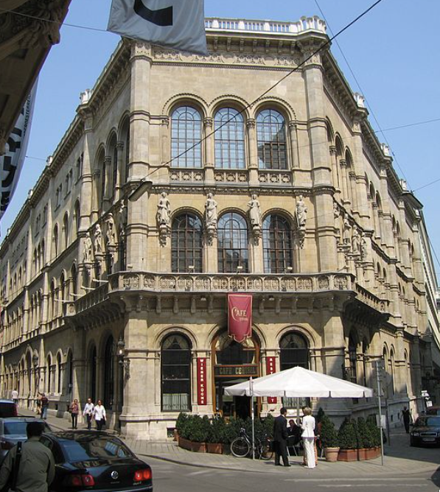
Failed Utopia: The Costs of the “Experiment”
Guenther Roth:
“Weber and Schumpeter... had their famous falling-out in a Viennese coffeehouse in 1918. Weber, ‘who took nothing lightly,’ and Schumpeter, who ‘took nothing hard,’ recalled Somary who witnessed the scene, clashed over the Russian Revolution…”
“Schumpeter welcomed it as a laboratory experiment…. For Weber it was going to be ‘a laboratory heaped with human corpses.’ When an enraged Weber stormed out, a smiling Schumpeter remarked: ‘How can someone carry on like that in a coffeehouse?’—the proper place for irony, never seriousness…”
1:00
Notes:
Failed Utopia: The Costs of the “Experiment”
Guenther Roth:
>Weber and Schumpeter... had their famous falling-out in a Viennese coffeehouse in 1918. Weber, ‘who took nothing lightly,’ and Schumpeter, who ‘took nothing hard,’ recalled Somary who witnessed the scene, clashed over the Russian Revolution…
>Schumpeter welcomed it as a laboratory experiment…. For Weber it was going to be ‘a laboratory heaped with human corpses.’ When an enraged Weber stormed out, a smiling Schumpeter remarked: ‘How can someone carry on like that in a coffeehouse?’—the proper place for irony, never seriousness…

Slide 22
Was RES the Alternative We Were Looking For?
The Great Depression came
Elected-representative parliamentary assemblies doing the governing and markets doing the economizing manifestly did not do the job
RES was one alternative
Why was RES necessary?
The rich would buy large megaphones and degrade the public sphere.
The rich would hire guards and mercenaries
The rich would resort to what Karl Marx and Friedrich Engels called a “pro-slavery rebellion”
Hence you had to make the omelette—and you cannot make an omelette without breaking eggs
It was socialism
It was existing
It was real
What would Marx have thought of it? Well, what would St. Paul have thought of modern-day evangelicals?
26:15 minutes of audio
4:00
Notes:
The Great Depression convinced many all that elected-representative parliamentary assemblies doing the governing and markets doing the economizing manifestly did not do the job. What were the options? One option was really existing socialism.
I write “really existing socialism” rather “Marxism” or “communism” because the Marxist movement had, by 1930, transformed itself from a river to a delta. We can at least point to what really-existing socialism was: the régimes that ruled the Soviet Union from its creation to destruction, that ruled the occupied Soviet satellites of Eastern Europe after World War II, post-Chiang Kaishek pre-Deng Xiaoping China, Cuba after 1959, and North Korea after 1945.
Other words? They were and are all up for grabs.
In Western Europe and North America after and indeed before World War I, most who called themselves any flavor of “socialist” held that in a good society there ought to be enormous scope for individual initiative, for diversity, for the decentralization of decision making, for liberal values, and for private property. In price regulation and in public ownership. the question was an empirical one: private where private belongs, public where it was needed, with circumstances altering cases. And representative democracy and rational argument could be trusted to settle things case-by-case.
But there were those who were less meliorist. The rich, especially, could buy large megaphones, their speech could seriously degrade the public sphere. The rich could hire guards and mercenaries and equip them with automatic weapons, so they could not be trusted to acquiesce when the mechanisms of representative government decided against them—they would then resort to what Karl Marx and Friedrich Engels called a “pro-slavery rebellion”, harking back to American southern slaveholders’ refusal to accept the election of Abraham Lincoln in 1860.
So the people needed to be ready to stand to arms to suppress such a rebellion. Perhaps the people, or rather the people who belonged to the progressive industrial working class that Marx and Engels had called the proletariat, needed to do more —to stand to arms to overcome institutional or bureaucratic blockages, or even, perhaps, to offset the hegemony of the ideas of the ruling class in the public sphere by depriving classes whose interests were opposed to the general and public interest the rights to vote or speak.
You had to make the omelette. That is what the Great Depression demonstrated. And you cannot make an omelette without breaking eggs.
From 1917-1990, really existing socialism:
• was socialism in that it claimed to be as close as there was or could be to Marx's and other socialists’ of the 1800s hopes.
• was existing in that it was there, on the ground, in régimes that at their peak ruled perhaps one-third of the world’s population.
• was real in that it was not an intellectual utopian fantasy or a dream, but rather a necessary compromise with the messiness of this world that its propagandists and apparatchiks claimed was as close as possible to utopia.
It is now gone.
What would Marx have thought of it?
Throughout most of really existing socialism’s career, Marx would probably have regarded most of it with the dismay and perhaps disdain that St. Paul would have felt for evangelicals who misinterpret his strictures against rituals as strictures against the works of mercy,. Those and claim as long as you had accepted Jesus Christ as your personal savior “in your heart” it was unimportant whether you fed your hungry, nursed your sick, visited your imprisoned neighbors, or loved your neighbor—even the hated and loathed Samaritans—as yourself.

Slide 23
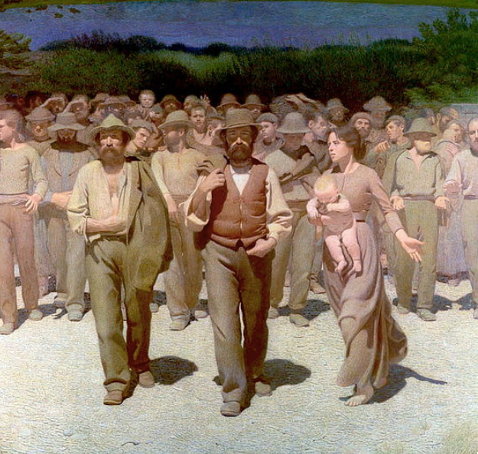
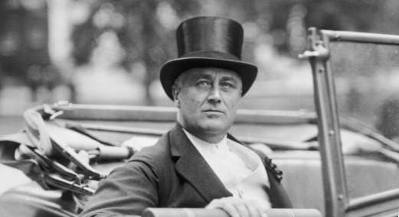
RES Not, in the End, Irresistible or Even Popular
Ernst Gellner:
“Just as the most extreme Shi’ite Muslims held that Archangel Gabriel made a mistake, delivering the Message to Muhammed when it was intended for Ali…
“so Marxists… think… [the] message was intended for classes, but was delivered to nations.
“It is now necessary for revolutionary activists to persuade the wrongful recipient to hand over the message and the zeal…”
1:30
Notes:
Czechoslovak-British sociologist Ernest Gellner had a cruel way of describing the surprise and shock of the followers of really existing socialism when it turned out in the end that their doctrines were not irresistible or even popular. Rather than the overwhelming mass of a people in waves of enthusiasm enthusiastically installing really existing socialist regimes over the globe, such regimes only appeared where armies marched. They were then consolidated by bait-and-switch. First, popularity was gained by distributing land to the peasants. Then, after the regime was consolidated, the peasants were reenserfed and herded into communes under the guns of the army and the secret police, and under the authority of the apparatchiks of the party.
As Gellner wrote:
>Just as the most extreme Shi’ite Muslims held that Archangel Gabriel made a mistake, delivering the Message to Muhammed when it was intended for Ali…
>So Marxists… think… [the] message was intended for classes, but was delivered to nations.
>It is now necessary for revolutionary activists to persuade the wrongful recipient to hand over the message and the zeal…
For it was movements based on nation and ethnicity—that the people, poor and rich, were brothers and sisters who ought to act in solidarity under the direction of a leader against enemies foreign and domestic—who had an easier time rallying support from 1900 to 1950 and, indeed, from 1990 to today.

Slide 24
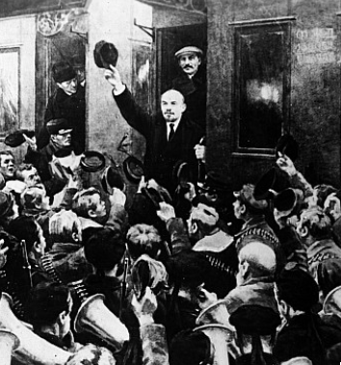
The Soviet Trajectory
Imperatives
Survive
Eliminate large-scale private property and market
Industrialize
No aid coming from Germany
War Communism
War Terror
NEP
“Scissors Crisis”
Capital as a business model
6:00
Notes:
Really existing socialism at the end of World War I found itself under the leadership of Vladimir Lenin and confined to one country—albeit a very large country—and to a very poor country, in which few had ever imagined socialism might be attempted: Russia. How could they succeed at such a task, when none of them had ever done anything other than organize political rallies and write propaganda?
Lenin stepped back from “War Communism” to the “New Economic Policy”, letting prices rise and fall, letting people buy and sell and get richer, requiring that managers of government factories make profits or be sacked.
By 1927 the new Soviet Union was back—in life expectancy, in population, in industrial production, in standards of living—to what it had been in 1914. And there was no longer the deadweight of the Czarist aristocracy consuming resources and keeping the country down. As long as Lenin’s successors could avoid destroying the country through their own mistakes, and as long as they could keep the baseline to which people compared them to the privations and chaos of war, plague, and civil war, it would be hard for them to be very unpopular.
The first imperative facing Lenin's regime was to eliminate capitalism by nationalizing private property and removing business owners from management. But how do you run industry and economic life in the absence of business owners—of people whose incomes and social standing depend directly on the prosperity of individual enterprises, and who thus have the incentives and the power to try to make and keep individual pieces of the economy productive and functioning?
Lenin’s answer was that you organize the economy like an army: top down, planned, hierarchical, with undermanagers promoted, fired, or shot depending on how well they attained the missions that the high economic command had assigned them.
Lenin had been impressed by what he saw of the German centrally-directed war economy of World War I:
>The war has reaffirmed... that modern capitalist society... has fully matured for the transition to socialism. If... Germany can direct the economic life of 66 million people from a single, central institution... then the same can be done... by the nonpropertied masses if their struggle is directed by the class-conscious workers.... Expropriate the banks and... carry out in [the masses’] interests the same thing the [wartime] Weapons and Ammunition Supply Department is carrying out in Germany…
The World-War I era German war economy, as run by Walther Rathenau, his advisor Wichard von Moellendorff, and their colleagues in the Prussian War Ministry’s Raw Materials Section started with war materials, especially ammunition, especially explosives—which meant nitrogen compounds—were the first to come under the aegis of planning. Foodstuffs followed. War expenditures rose from one-sixth of national income to two-thirds. The government began planning and commanding not just the movement of key raw materials to and through the factories and then finished products off to the front, but that factories be expanded and built to provide for additional war production.
So things were in the Soviet Union.
By 1928 Lenin was dead and Josef Stalin was in the driver’s seat. He claimed that the “scissors crisis” was caused by a few bad-apple rich peasants who were holding back their grain in order to extort unfairly high prices: the kulaks. The kulaks were the problem. If there were no kulaks, no problem.
Stalin called for the reenserfment of the peasantry: the forced movement of peasants into communes run by bosses working for the state. This would, Stalin claimed, boost agricultural productivity massively: communes could realize economies of scale and build up agricultural machinery to a level impossible for a small farm. And the state could then set peasant standards of living as low as it wished, and so gather resources for rapid industrialization and urbanization. This process of industrialization would be guided by the planning process, calculating material balances for key commodities and rationing materials in scarce supply to the highest productivity uses.
The system had very limited coverage. The planners could only track material balances for 100 commodities in the mid-1930s.
Yet the system worked surprisingly well.
How? Commodities subject to material balance control were tracked. Those who did not fulfill their goals according to the plan were sanctioned. Otherwise, commodities were exchanged between businesses and out to users either through standard market cash-on-the-barrelhead transactions or via blat: connections:
>the use of personal influence for obtaining certain favors for which a firm or individual is not legally or formally entitled…
Where none of personal blat, market exchange, nor the plan could obtain the raw materials an enterprise needed to appear to be successfully contribution to the plan, there was another option: the tolkach, the fixer-intermediary. Individuals want to accomplish the mission of the organization, please their bosses so they don’t get fired (or to get promoted), and assist others. They swap favors, formally or informally. They note that particular goals and benchmarks are high priorities, and that the top bosses will be displeased if they are not accomplished. They use social engineering and arm-twisting skills. They ask for permission to outsource, or dig into their own pockets for incidentals. Market, barter, blat, and plan. The system held together.

Slide 25
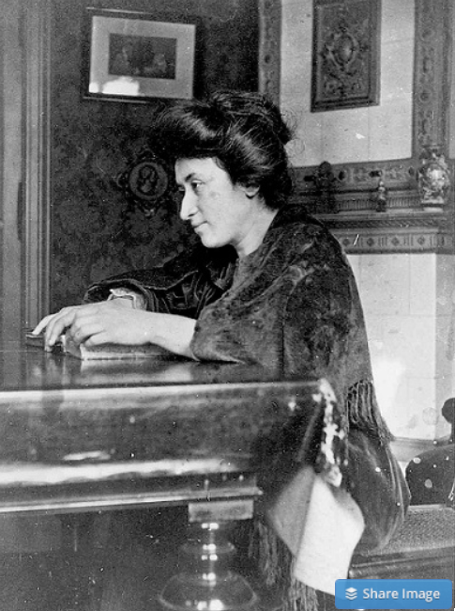
Failed Utopia: Politics
Rosa Luxemburg:
“The tacit assumption underlying the Lenin-Trotsky theory of dictatorship is this: that the socialist transformation is something for which a ready-made formula lies completed in the pocket of the revolutionary party…. We [do] know more or less what we must eliminate…
“But when it comes to the nature of the thousand concrete, practical measures, large and small, necessary to introduce socialist principles into economy, law and all social relationships, there is no key in any socialist party program or textbook. That is not a shortcoming but rather the very thing that makes scientific socialism superior to the utopian varieties…”
That makes sense
So why did what Lenin did work—after a fashion?
Following a previous path—simply look west, and duplicate…
Material balance control of key commodities, exchange, command, barter, blat, tolkachi, &social network favor exchanges could accomplish that…
2:00
Notes:
The system held together and delivered a higher standard of living to Russians—those not executed or sent to concentration camps—than they had had before 1914. The system held together politically as well—but was not an improvement over the pre-1914 Czarist regime, not by a long shot.
Could the system lead to a utopia?
Almost surely not: As Red Rosa—Rosa Luxemburg—wrote before her murder in 1918:
>The tacit assumption underlying the Lenin-Trotsky theory of dictatorship is this: that the socialist transformation is something for which a ready-made formula lies completed in the pocket of the revolutionary party….
>We [do] know more or less what we must eliminate…. But when it comes to the nature of the thousand concrete, practical measures, large and small, necessary to introduce socialist principles into economy, law and all social relationships, there is no key in any socialist party program or textbook. That is not a shortcoming but rather the very thing that makes scientific socialism superior to the utopian varieties…
That makes sense. So why did what Lenin did work—after a fashion?
The answer is that they were following a previous path—simply look west, and duplicate what you see, bringing in foreign experts to do the construction managing and engineering. Material balance control of key commodities, exchange, command, barter, blat, tolkachniki, & social network favor exchanges could accomplish that—and that was something: resource mobliization plus deployment in standardized, elsewhere-tested forms. That could produce a society much richer than Russia before 1914.

Slide 26
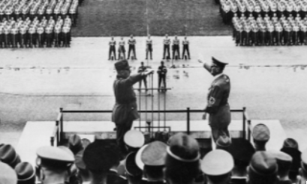
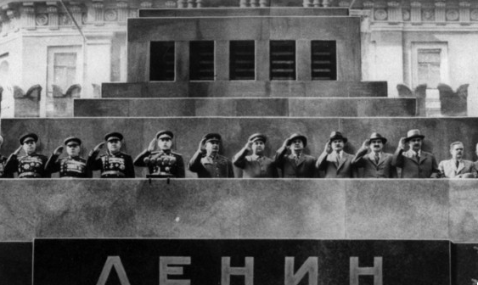
Would a Non-Authoritarian Communism Have Been So Bad?
John Maynard Keynes:
“Russian Communism… tries to construct a framework… in which pecuniary motives… shall have a changed relative importance…. Money-making…will simply not occur to a respectable young man as a possible opening, any more than the career of a gentleman burglar or acquiring skill in forgery and embezzlement….
“This system does not mean a complete leveling down of incomes…. The private trader is a sort of permitted outlaw, without privileges or protection…. The effect of these social changes has been, I think, to make a real change in the predominant attitude towards money…. Money-making and money-accumulating cannot enter into the life-calculations of a rational man who accepts the Soviet rule in the way in which they enter into ours….
“All this may prove Utopian, or destructive of true welfare, though, perhaps, not so Utopian, pursued in an intense religious spirit, as it would be if it were pursued in a matter-of-fact way.
“But is it appropriate to assume, as most of us have assumed hitherto, that it is insincere or wicked?…”
Keynes an upper-class twit…
& did not like the business class much…
& RES was pretty wicked…
& massively inefficient
But its major sins in its first generation were political and anti-human rather than economic
& from Keynes’s standpoint, the economic problem was not the permanent problem of the human race—economists should aspire to be like dentists, keeping things in functioning order, and otherwise staying in the background
2:15
Notes:
Would it have been so bad if it could have kept from being so authoritarian, so murderous, so purge-ridden? John Maynard Keynes thought it did not—in fact, that it was not so bad:
>Russian Communism… tries to construct a framework… in which pecuniary motives… shall have a changed relative importance…. Money-making… will simply not occur to a respectable young man as a possible opening, any more than the career of a gentleman burglar or acquiring skill in forgery and embezzlement….
>This system does not mean a complete leveling down of incomes…. The private trader is a sort of permitted outlaw, without privileges or protection…. The effect of these social changes has been, I think, to make a real change in the predominant attitude towards money…. Money-making and money-accumulating cannot enter into the life-calculations of a rational man who accepts the Soviet rule in the way in which they enter into ours….
>All this may prove Utopian, or destructive of true welfare, though, perhaps, not so Utopian, pursued in an intense religious spirit, as it would be if it were pursued in a matter-of-fact way.
>But is it appropriate to assume, as most of us have assumed hitherto, that it is insincere or wicked?…
Keynes was an upper-class twit who vastly preferred artists, intellectuals, and the leisured to the money-grubbing business class in either its high-finance or low-shopkeeper forms. And Keynes was wrong: it was massively wicked. And Keynes was right: it was massively inefficient. And Keynes was right: it did turn an error-ridden economic treatise into a Holy Writ, that then had to be frantically reinterpreted and re-reinterpreted to match the twists and turns of the party line, and was, as an intellectual pursuit, silly and monstrous and monstrously silly.
But Keynes was still relatively optimistic about it. Remember, for Keynes, the economic problem was not the permanent problem of the human race—economists should aspire to be like dentists, keeping things in functioning order, and otherwise staying in the background.
And really existing socialism’s major sins in its first generation were political and anti-human, rather than its transgressions against the laws of economics and economic efficiency.

Slide 27
The Soviet Union: Late Development
What is the benchmark?
If the Soviet Union was “European” or “recent settlement”—an absolute disaster.
If you compare the Soviet Block to the countries around its edge—an absolute disaster
Why? Because bureaucracies undisciplined by markets are really not very good at organizing production
They can—sometimes—duplicate things they can see elsewhere
They can—sometimes—generate amazing feats of resource mobilization
While sharply reducing “profiteering”
When do we want “hard incentives”, anyway?
The secret of the corporation
Disciplined by market at its edges—and that matters
RES and wartime mobilization
4:00
Notes:
If the benchmark against which we measure the economy of the Soviet Union and its satellites is a “western European” or a “recent settlement” benchmark, it is an absolute disaster. Compare the Soviet Bloc to the countries around its edge—those fortunate enough to have escaped conquest by the Red Army or the People’s Liberation Army—at the end of the 1980s, when the system collapsed. Whether we compare North to South Korea, China to Taiwan, Cambodia to Thailand, Hungary to Austria, Poland to Sweden, or Cuba to Mexico, the countries outside the Iron Curtain are five times richer.
Why? Because bureaucracies undisciplined by markets are really not very good at organizing production. They can—sometimes—duplicate things they can see elsewhere. They can—sometimes—generate amazing feats of resource mobilization toward a single end—producing T-34C tanks. They can sharply reduce “profiteering”. That seems to be all they can do.
So it limped along. Where none of personal blat, market exchange, nor the plan could obtain the raw materials an enterprise needed to appear to be successfully contributing to the plan, there was another option: the tolkach. Tolkachi would find out who had the goods you needed, and what goods you might be able to acquire those who had the goods you needed might value. They were barter agents. In 1930, only two years after the turn away from the NEP, there were already more than 2500 tolkachi hard at work in Moscow alone.
One hidden secret of capitalist business is that most companies’ internal organizations are a lot like the crude material balance calculations of the Soviet planners. Inside the firm, commodities and time are not allocated through any kind of market process. Individuals want to accomplish the mission of the organization, please their bosses so they don’t get fired (or to get promoted), and assist others. They swap favors, formally or informally. They note that particular goals and benchmarks are high priorities, and that the top bosses will be displeased if they are not accomplished. They use social engineering and arm-twisting skills. They ask for permission to outsource, or dig into their own pockets for incidentals. Market, barter, blat, and plan understood as the organization’s primary purposes always rule, albeit in different proportions, with the market confined to the external interfaces of most organizations.
The difference is that a standard business firm is embedded in a much larger market economy, and so is always facing the make-or-buy decision: can this resource needed be acquired most efficiently from elsewhere within the firm, via social engineering or arm-twisting or blat, or is it better to seek budgetary authority to purchase it from outside, or even to dig into one’s own personal pocket to save the hastle? That make-or-buy decision is a powerful factor keeping businesses in capitalist market economies on their toes, and more efficient.
And in capitalist market economies factory-owning firms are surrounded by clouds of middlemen whose livelihoods depend on their anticipating demand and finding supplies. The broad market interfaces of individual factories and the clouds of middlemen were absent in the Soviet Union. Hence its economy was grossly wasteful.
But, though wasteful, material-balance control is an expedient that pretty much all societies adopt during wartime. Then hitting a small number of specific targets for production becomes the highest priority. Then allowing market prices to grossly fluctuate and massively enrich some and impoverish others dissolves societal harmony.

Slide 28
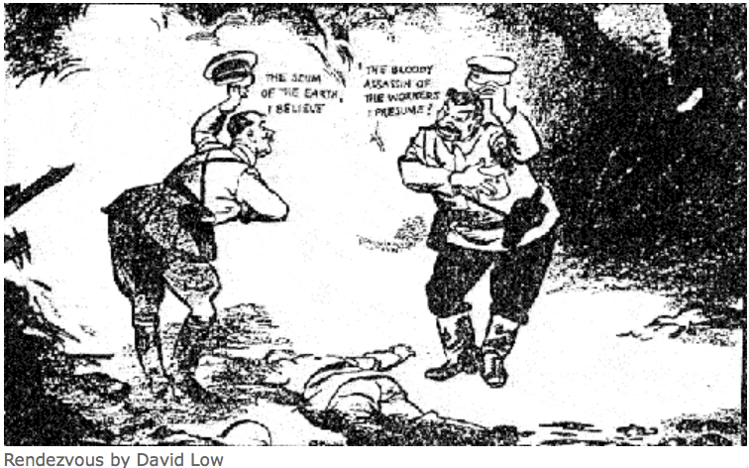
The Soviet Union: Tyranny
Should we dismiss the Soviet Union as simply a tyranny?
One in which the standard ways of bullying and oppressing people are reinforced by technologies of bureaucracy and indoctrination?
“Fake News” goes back to the Norman Conquest, after all…
We are just better at it…
Russian Civil War: 3M? Collectivization of agriculture: 10M? Great Terror: 2M? Post-WWII purge: 2M? Anti-landlordism: 4M? Collectivization: 4M? Great Leap Forward famine: 50M? Cultural Revolution: 5M? Pol Pot: 1.5M? Kim Dynasty: ????
Eric Hobsbawm: “In a period in which, as you might imagine, mass murder and mass suffering are absolutely universal, the chance of a new world being born in great suffering would still have been worth backing. Now the point is, looking back as an historian, I would say that the sacrifices made by the Russian people were probably only marginally worthwhile. The sacrifices were enormous; they were excessive by almost any standard and excessively great. But I'm looking back at it now and I'm saying that because it turns out that the Soviet Union was not the beginning of the world revolution.
“Had it been, I'm not sure. After all, do people say we should not have fought World War II? More people died in World War Ii than died in Stalin's terror.... Had the radiant tomorrow actually been created the loss of 15-20 million people might have been justified…”
3:00
Notes:
Should we dismiss the Soviet Union as simply a tyranny? Another in the sad roll of régimes of inequality and domination, made worse than almost all in this case because of bureaucracy, machinery, and a religous devotion to whatever current orthodoxy was decreed by today’s high priests in Moscow’s Kremlin? One in which the standard ways of bullying and oppressing people were amped up and reinforced by technologies of bureaucracy and indoctrination—just as technologies had amped up production? “Fake News” goes back to the Norman Conquest, after all…
We in the long 20th century are just better at it…
The butcher’s bill is impressive: The Russian Civil War: 3M? Collectivization of agriculture: 10M? Great Terror: 2M? Post-WWII purge: 2M? Anti-landlordism: 4M? Collectivization: 4M? Great Leap Forward famine: 50M? Cultural Revolution: 5M? Pol Pot: 1.5M? Kim Dynasty: ???? Add question marks after all those numbers. And add a triple question mark after North Korea’s Kim Dynasty.
Yet to the end of its days and beyond, it had its defenders. Consider British Marxist historian Eric Hobsbawm, who could write about how the post-WWII social democratic institutions of Britain needed and were improved by much of the cold neoliberal douche imposed by Margaret Thatcher.
Eric Hobsbawm could also write, of really existing socialism:
>In a period in which, as you might imagine, mass murder and mass suffering are absolutely universal, the chance of a new world being born in great suffering would still have been worth backing. Now the point is, looking back as an historian, I would say that the sacrifices made by the Russian people were probably only marginally worthwhile. The sacrifices were enormous; they were excessive by almost any standard and excessively great. But I'm looking back at it now and I'm saying that because it turns out that the Soviet Union was not the beginning of the world revolution.
>Had it been, I'm not sure. After all, do people say we should not have fought World War II? More people died in World War Ii than died in Stalin's terror.... Had the radiant tomorrow actually been created the loss of 15-20 million people might have been justified…
As best as I can figure out ,what Hobsbawm is thinking and not quite daring to say completely explicitly right here is this: Lenin and Stalin’s decision to sacrifice 15 to 20, milion people on the altar of Moloch in a bet that it would produce the Radiant Future was a good and worthwhile bet to make ex ante—just as WWII was a good war to fight—but just a bet that, unfortunately, did not pay off in the end.

Slide 29
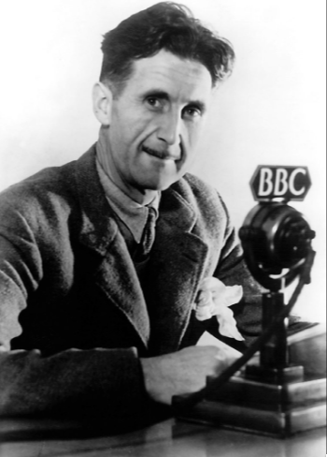
The George Orwell Tradition
Hannah Arendt’s Totalitarianism, George Orwell’s 1984 and Animal Farm, even Leon Trotsky:
Estate-based authoritarianism as the natural Agrarian Age form of government
Totalitarianism as the natural Industrial Age form of government: “a boot stamping on a human face, forever…”
What is “totalitarianism”?
Is it possible?
Is it stable?
Is it a model?
Religious or quasi-religious fervor?
Cf.: Hobsbawm
3:30
Notes:
Great worries spring from the experience of really existing socialism and fascism about the future of humanity. George Orwell’s novels 1984 and Animal Farm are the classic locus of this worry, as is Hannah Arendt’s Totalitarianism, and even a short beast fable by Leon Trotsky that goes like this:
>A cattle dealer once drove some bulls to the slaughterhouse. And the butcher came at night with his sharp knife. "Let us close ranks and jack up this executioner on our horns," suggested one of the bulls. "If you please, in what way is the butcher any worse than the dealer who drove us hither with his cudgel?" replied the other bulls, who had received their political education in Manuilsky's institute. "But we shall be able to attend to the dealer as well afterwards!" "Nothing doing," replied the other bulls firm in their principles, to the counselor. "You are trying, from the left, to shield our enemies—you are a social-butcher yourself." And they refused to close ranks…
The worry is that, just as estate- and status group-based authoritarianism is the natural Agrarian Age form of human government, so propoganda and party cadre-based totalitarianism is the natural Industrial Age form of government: “a boot stamping on a human face, forever…”, in Orwell’s phrasing. That the combination of propaganda, a cadre of those who receive ample material rewards, a cadre of those who receive ample spiritual rewards, and a very elastic attitude toward truth will be a stable point in the post-industrial age in a sense similar to warrior-cleric aristocracies of domination were in the Agrarian Age.
Three decades ago, with the triumph of liberal and social democracy and the mixed economy over both fascist alternatives to the right and really existing socialist alternatives to the left, these worries could be dismissed. But in today's world of a post-truth media and of a revival of ethnicism on the one hand and of leader-worship on the other, they cannot be so easily.
Indeed, whenever I think about the career of Eric Hobsbawm they greatly worry me. Consider these two passages from Hobsbawm’s works:
>[Only joining a] Moscow aligned Communist party... offered both to interpret the world and to change it, or looked better able to do so.... It was, for most of the world’s believers in the need for global revolution, the only game in town…. Lenin’s ‘party of a new type’… gave even small organizations disproportionate effectiveness, because the party could command extraordinary devotion and self-sacrifice from its members, more than military discipline and cohesiveness, and a total concentration on carrying out party decisions at all costs. This impressed even hostile observers profoundly…
And:
>[The allegiance of all Communist Parties to Moscow’s alliance with Hitler when World War II began was] something heroic…. Nationalism, political calculation, even common sense, pulled one way; yet they unhesitatingly chose to put the interests of the international movement first…. They were tragically and absurdly wrong. But their error... should not lead us to ridicule the spirit of their action. This is how the socialists of Europe should have acted... carrying out the decisions of the International.... It was not their fault that the International should have told them to do something else…
He was what Orwell most feared.

Slide 30
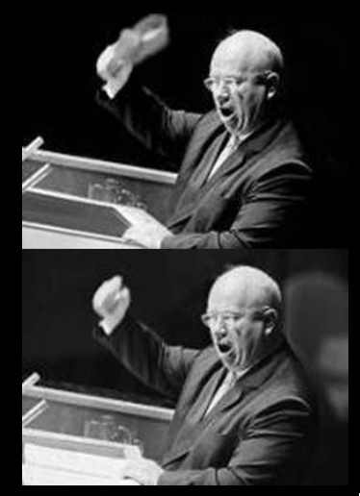
Failed Utopia: Our Friend Nikita Sergeyevitch
Francis Spufford: “So much blood, and only one justification for it…. If it had been all prologue, all only the last spasms of death in the old, cruel world…. Today the radio was reporting… Prague….
“He fumbled with the tape machine… found the RECORD key…. ‘Paradise’, he told the wheat field in baffled fury: ‘is a place where people want to end up, not a place they run from. What kind of socialism is that? What kind of shit is that, when you have to keep people in chains. What kind of social order? What kind of paradise?…’
“And then… the retired monster sat very still on the bench by the field…”
1:00
Notes:
In his novel Red Plenty, author Francis Spufford puts the final word into teh mouth of his character—not the historical—Soviet leader Nikita Khrushchev, who looks back at his life and sees that it was all working and bulding and killing to, in the end, construct nothing but a pile of shit:
>So much blood, and only one justification for it…. If it had been all prologue, all only the last spasms of death in the old, cruel world…. Today the radio was reporting… [anti-Soviet domenstrations in] Prague….
>He fumbled with the tape machine… found the RECORD key…. ‘Paradise’, he told the wheat field in baffled fury: ‘is a place where people want to end up, not a place they run from. What kind of socialism is that? What kind of shit is that, when you have to keep people in chains? What kind of social order? What kind of paradise?…’
>And then… the retired monster sat very still on the bench by the field…

Slide 31
Big Ideas: Lecture 19: Behind the Iron Curtain
Takeaways from this class:

Slide 32
Roadmap for the Next Two Weeks…
5. Touring the Continents
19. Tu Apr 7: 5.2.1. Behind the Iron Curtain
Read Before: Richard Ericson (1991): The Classical Soviet-Type Economy: Nature of the System and Implications for Reform <https://delong.typepad.com/files/ericson-soviet.pdf>
Slides: <https://github.com/braddelong/public-files/blob/master/econ-135-lecture-19.pptx>
20. Th Apr 9: 5.2.2. East Asian Miracles
Read Before: Peter Evans (1995): Embedded Autonomy: States and Industrial Transformation, chapter 1 <https://delong.typepad.com/files/evans-embedded-i.pdf>
Read Before: Yingyi Qian (2001): How Reform Worked in China <https://delong.typepad.com/files/qian-reform.pdf>
Slides: <https://github.com/braddelong/public-files/blob/master/econ-135-lecture-20.pptx>
21. Tu Apr 14: 5.3. Asia and Africa
Read Before: Nathan Nunn (2008): The Long Term Effects of Africa's Slave Trades <https://dash.harvard.edu/bitstream/handle/1/3710252/Nunn_Long-TermEffects.pdf>
Read Before: Sevkut Pamuk (2014): Institutional Change and Economic Development in the Middle East, 700-1800 <https://delong.typepad.com/files/pamuk.pdf>
Slides: <https://github.com/braddelong/public-files/blob/master/econ-135-lecture-21.pptx>
6. Policy Issues
22. Th Apr 16: 6.1. "Deep Roots" vs. Path Dependence
Read Before: Nathan Nunn (2012): Culture and the Historical Process <https://delong.typepad.com/files/nunn-culture.pdf>
Read Before: Melissa Dell (2015): Path Dependence in Development: Evidence from the Mexican Revolution <https://scholar.harvard.edu/files/dell/files/revolutiondraft.pdf>
Slides: <https://github.com/braddelong/public-files/blob/master/econ-135-lecture-22.pptx>
23. Tu Apr 21: 6.2. Growth and Fluctuations; Trade and Development, Foreign Aid
Read Before: Barry Eichengreen (2015): Hall of Mirrors: The Great Depression, The Great Recession, and the Uses-and Misuses-of History, selections <https://delong.typepad.com/files/eichengreen-mirrors.pdf>
Read Before: David Atkin (2014): Endogenous Skill Acquisition and Export Manufacturing in Mexico <https://delong.typepad.com/files/atkin-skill.pdf>
Slides: <https://github.com/braddelong/public-files/blob/master/econ-135-lecture-23.pptx>

Slide 33
Roadmap Following: 6. Policy Issues…
Th Apr 23: 6.3. Populism, Plutocracy, Kleptocracy, & Neo-Fascism
Read Before: Ernest Gellner (1973): Nations & Nationalism, selections <https://delong.typepad.com/files/gellner-nations.pdf>
Read Before: Barry Eichengreen (2018): The Populist Temptation Economic Grievance & Political Reaction in the Modern Era, selections <https://delong.typepad.com/files/eichengeeen-populist.pdf >
Tu Apr 28: 6.4. Global Warming
Read Before: Melissa Dell et al. (2012): Temperature Shocks & Economic Growth: Evidence from the Last Half Century <https://scholar.harvard.edu/files/dell/files/aej_temperature.pdf>
Read Before: Melissa Dell et al. (2014). What Do We Learn from the Weather? The New Climate-Economy Literature, selections <https://economics.mit.edu/files/9138>
Th Apr 30: 6.5. The Pace and Meaning of Economic Growth
Read Before: William Nordhaus: Do Real-Output and Real-Wage Measures Capture Reality? <https://www.nber.org/chapters/c6064.pdf>
Read Before: John Maynard Keynes: Economic Possibilities for Our Grandchildren<<https://delong.typepad.com/files/keynes-persuasion.pdf>
Read Before: Edward Bellamy (1887): Looking Backward 2000-1887, selections <https://delong.typepad.com/files/bellamy-backward.pdf>
7. Conclusion
Tu May 5: 7. Conclusion: The Future?
Read After: Robert Allen (2011): Global Economic History: A Very Short Introduction, selections <https://delong.typepad.com/files/allen-geh.pdf >
W May 13 11:30-14:30: FINAL PAPER/PROJECT DUE

Slide 34
Catch Our Breath…
Ask a couple of questions?
Make a couple of comments?
Any more readings to recommend?

Slide 35
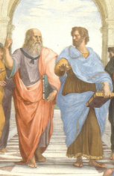
Notes, etc.…

Slide 36
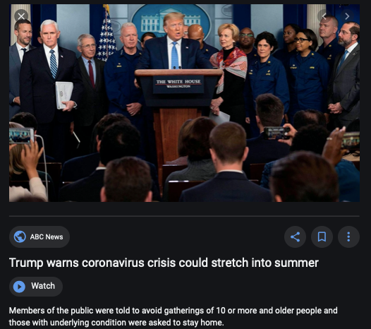
Coronavirus!

Slide 37
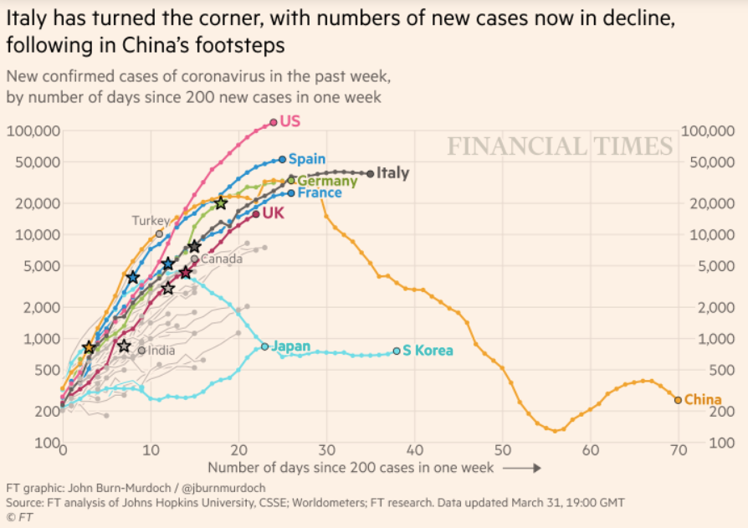
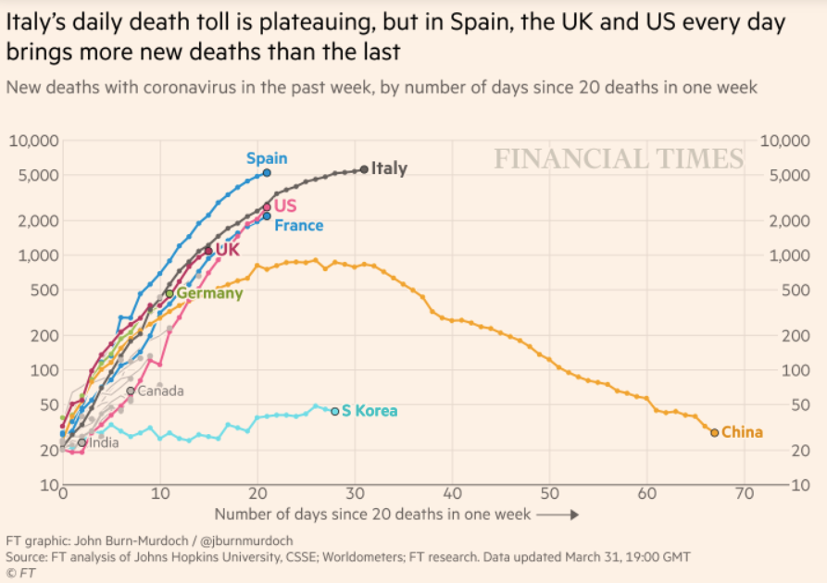
Coronavirus
Where we think we are as of Wed Apr 1:
We really do not know
No random samples…
Best thing I have read comes from Jim Stock <https://drive.google.com/file/d/12MV466ZZy5xHir4xdPhoTrL1oO8CbZU-/view>:
The basic SIR epidemiological model of contagion
The effect of social distancing and business shutdowns on epidemic dynamics enters the model through a single parameter: the case transmission rate β
Re-express the model in terms of β and the asymptomatic (or not very symptomatic) hence non-tested rate—the fraction of the infected who are not tested
The COVID-19 non-testing rate is unidentified in our model
Estimates in the epidemiological literature range from 0.18 to 0.86.
The asymptomatic rate could be estimated accurately and quickly by testing a random sample
The optimal policy response and its economic consequences hinge critically on the asymptomatic rate

Slide 38
Financial Times Graphs Blown Up…

Slide 41



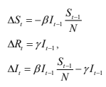
James Stock (2020)
Standard SIR model:<https://drive.google.com/file/d/12MV466ZZy5xHir4xdPhoTrL1oO8CbZU-/view>:
Susceptible, Infected, Recovered (& immune), transmission rate β, recovery rate γ, reproduction number R0, asymptomatic hence non-tested rate π0
Calibration: half-life of infection one week: γ = 0.5, s0 = 0.02, 50 cases on Jan 24
For March 21, 2020, the positive test rate in the United States is approximately 10%…
<https://drive.google.com/file/d/12MV466ZZy5xHir4xdPhoTrL1oO8CbZU-/view>

Slide 46
Bringing the Economy Back Up from Anæsthesia
Major issues:
Certificates of immunity:
Which requires test, test, test:
And not just disease virus tests
Presence-of-antibodies tests
How quickly can we match the immune with public-contact jobs?
What jobs can be done with minimal infection risk?
What minimal-infection substitutes can we find for previous jobs?
How quickly can restrictions be relaxed without the virus coming roaring back?
How do we avoid having the market give a “shutdown” signal to enterprises we in fact want restarted?
Which is pretty much all of them
How much of the potential caseload do we want to push out beyond the vaccine-arrival date?
ALL THESE QUESTIONS ARE ANSWERABLE IF WE LEARN THE ASYMPTOMATIC HENCE NON-TESTED RATE!!

Slide 47
Keeping the Economy from Crashing During the Lockdown
Nick Rowe: We have a 50% output cut in 100% of the sectors:
A temporary 100% output cut in 50% of the sectors (what the Coronavirus does) is very different from a 50% output cut in 100% of the sectors
Nick’s thought experiment:
In three months we are going to invent unobtanium:
Substantial intertemporal substitutibility
Plus lower cross-good contemporaneous substitutitbility
Hence high desired savings rate now
Flex-price market thus produces a nominal rate at the zero lower bound and a high inflation rate over the next three to six months
Plus liquidity-constrained workers in affected sectors see their demand go to zero immediately
Can we get there? Should we get there? What should we do instead?
We need a good RBC economist: are there any?…
<https://worthwhile.typepad.com/worthwhile_canadian_initi/2020/03/relative-supply-shocks-unobtainium-walras-law-and-the-coronavirus.html>

Slide 48
Keeping the Economy from Crashing During the Lockdown II
Nick Rowe <https://worthwhile.typepad.com/worthwhile_canadian_initi/2020/03/relative-supply-shocks-unobtainium-walras-law-and-the-coronavirus.html>:
Plus: to extend the thought experiment:
We just lost the ability to make “unobtainium”
So we should be substituting leisure for work, and moving workers into relatively unproductive labor, making the commodities we can still produce right now
How should relative prices move as a result? How should we make them move?
Plus: distributional issues
Plus: bankruptcy and credit chain issues

Slide 49

MOAR Coronavirus!
Death for Geezers!
Mortality for the Youngs very low…
It’s the flu for them—for you…
And an extra doubling—or is it 5%?—mortality for the asthmatic
And an extra doubling—or is it 5%?—mortality for the overweight

Slide 50
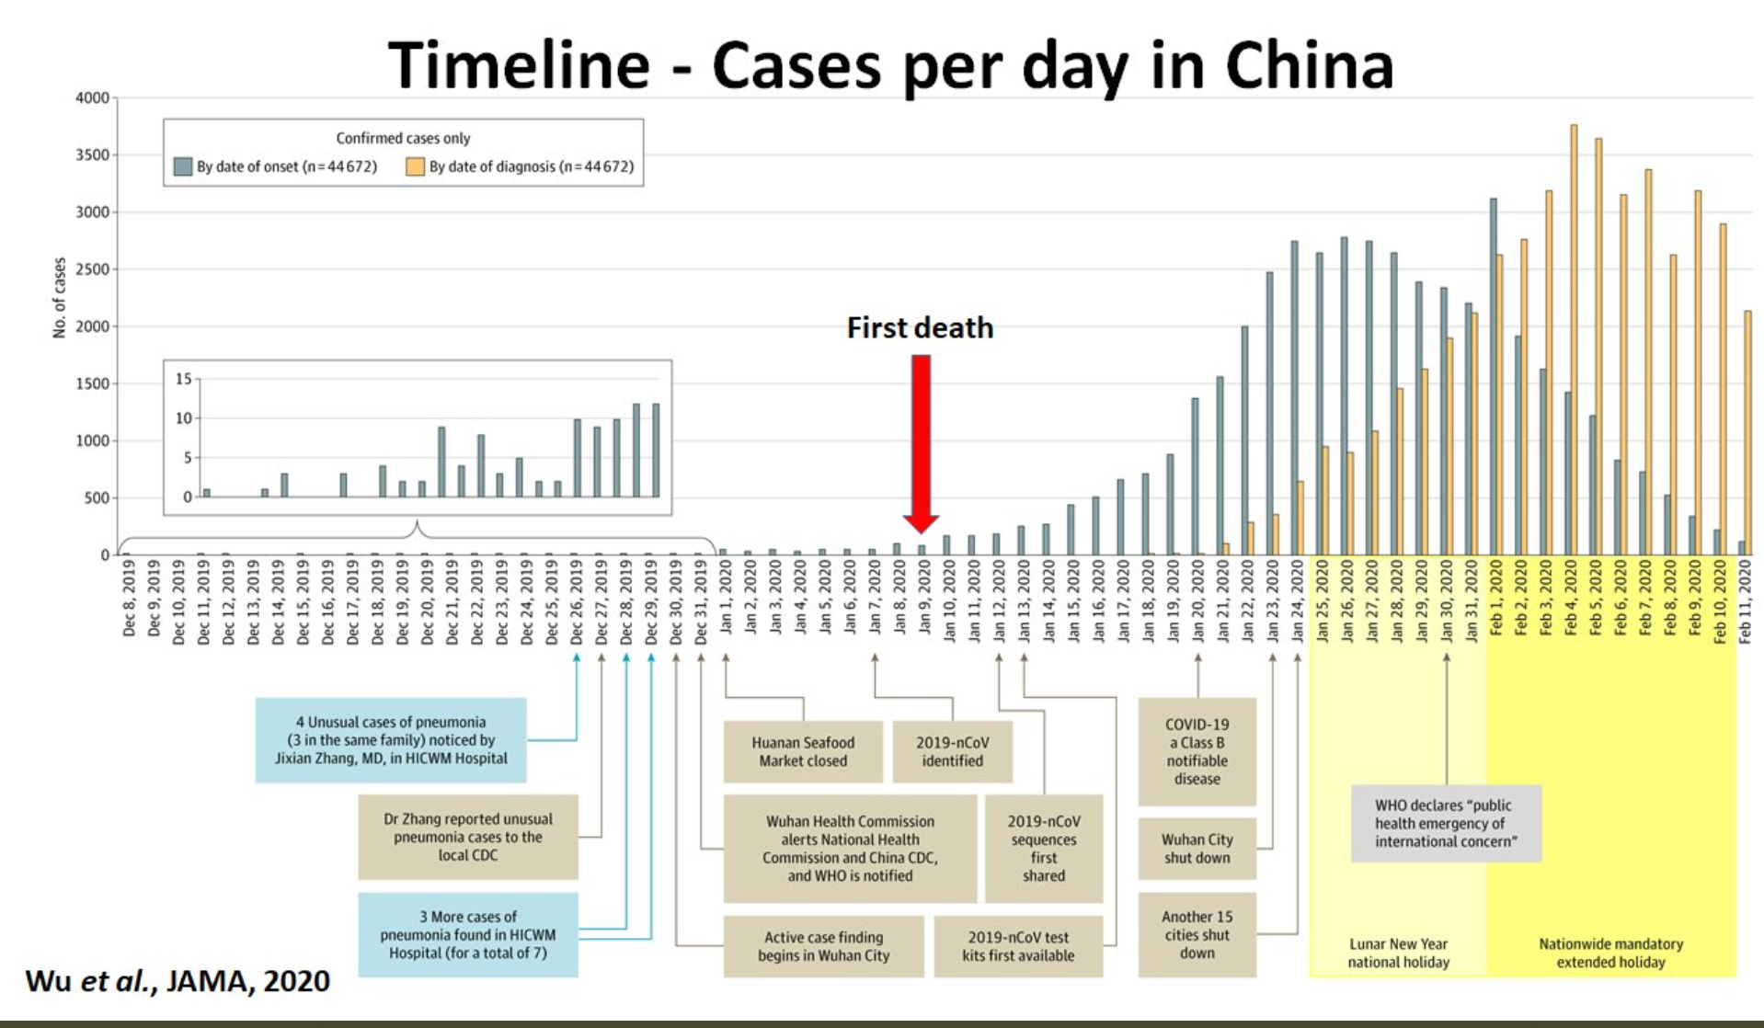
What We Think Happened in Wuhan
China beat it quickly & relatively easily!
We think
Shut down Wuhan when 200 cases per day
That seems to have been a good decision

Slide 51

The Goal
When Is It Appropriate to Move on This?
Immediate social distancing…
Self-isolate if you have a cough and a fever…
Hope that warmer temperatures will do to this what they did to SARS…
Otherwise, when do you want to start spreading out transmission. It seems that early is as good as later, so do it early…
I have no good intuition on why you want to move early
Plus your moving early will be wasted if you get reinfected
Plus the sparks you throw off making others’ lives more difficult

Slide 52
References
Financial Times (2020): Coronavirus Tracked: The Latest Figures as the Pandemic Spreads <https://www.ft.com/coronavirus-latest>
Nick Rowe (2020): Relative Supply Shocks, Unobtainium, Walras' Law, and the Coronavirus <https://worthwhile.typepad.com/worthwhile_canadian_initi/2020/03/relative-supply-shocks-unobtainium-walras-law-and-the-coronavirus.html>
Jim Stock (2020): Coronavirus Data Gaps and the Policy Response <https://drive.google.com/file/d/12MV466ZZy5xHir4xdPhoTrL1oO8CbZU-/view>

Slide 53
MOAR Coronavirus!
What I am watching:
Max Roser & Hannah Ritchie: Coronavirus Disease (COVID-19) <https://ourworldindata.org/coronavirus>…
Worldometer: Coronavirus Update (Live) <https://www.worldometers.info/coronavirus/>: ‘125,599 Cases and 4,605 Deaths from COVID-19 Virus Outbreak…
FT Coronavirus Tracker <https://www.ft.com/content/a26fbf7e-48f8-11ea-aeb3-955839e06441>
Josh Marshall’s COVID Twitter List <https://twitter.com/i/lists/1233998285779632128>
NEJM Group: Updates on the Covid-19 Pandemic <http://m.n.nejm.org/nl/jsp/m.jsp?c=%40kxNtXckRDOq8oG0jJvAXsIzN4mPECIPhltxoTSdTU9k%3D&cid=DM89089_NEJM_COVID-19_Newsletter&bid=173498255>: 'From the New England Journal of Medicine, NEJM Journal Watch, NEJM Catalyst, and other trusted sources...

Slide 54
Catch Our Breath…
Ask a couple of questions?
Make a couple of comments?
Any more readings to recommend?
<https://www.icloud.com/keynote/0YKEi7HeOrVGvKYtt9FEqH7nA>

